Slide 1


Exploratory Analysis of Segmentation Techniques for Multiphase Flow Experimental Images
Author: Jorge Costa
Supervisors: Mónica Silva, Zafeiris Kokkinogenis
04-02-2026

Slide 2
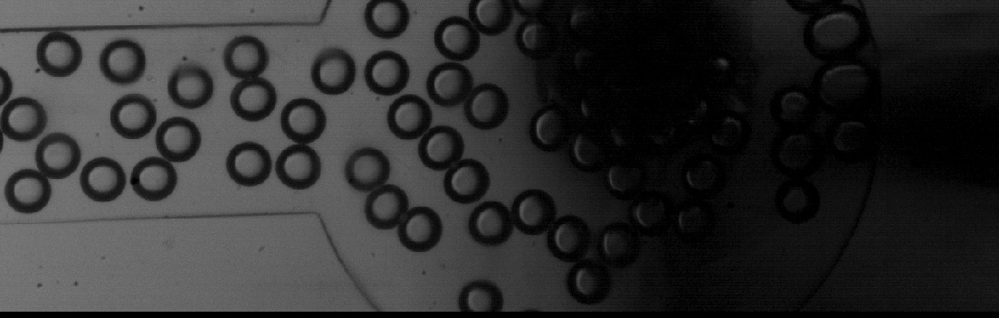
Why segmentation matters
Measurements from images:
bubble count, size/area statistics
Experimental/industrial relevance:
monitoring and quantifying multiphase flows
Need instance segmentation:
one mask per bubble (not just foreground/background)
Figure 1: Experimental Image showing lighting variability and blur.
Notes:
Segmentation is not the end goal; it enables measurement. In multiphase-flow imaging, we want quantitative outputs like count and size distributions, so we need instance-level masks.

Slide 3
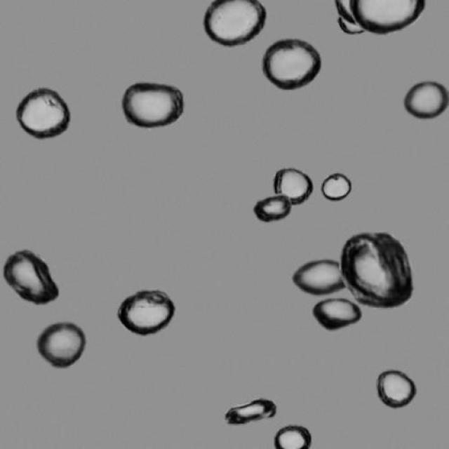
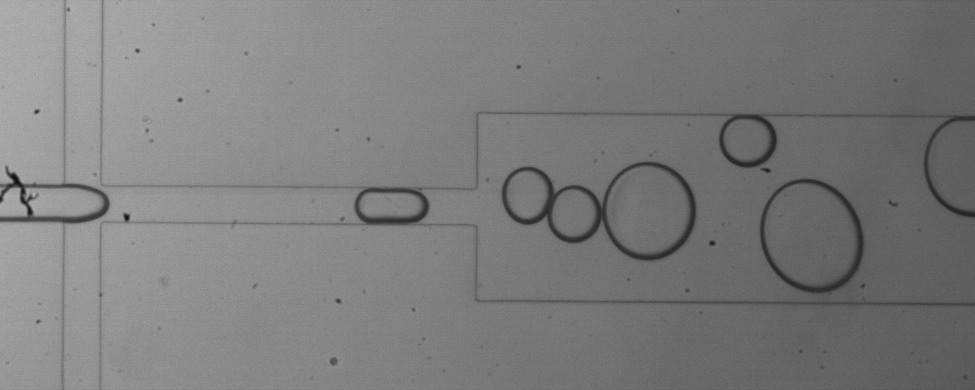
Key challenges and motivation
Annotation bottleneck: pixel-accurate instance labels are expensive
Real-image difficulty: overlap/occlusions, low contrast, lighting artifacts
Domain gap: synthetic-trained models don’t fully generalize to real experiments
My approach: controlled model comparison + synthetic→real transfer + annotation assistance + measurement-aligned metrics
Figure 3: Real Experimental Image
Figure 2: Synthetic Image
Notes:
Working with real experimental data is hard for two reasons. First, producing instance-level ground truth is slow and ambiguous, especially in dense scenes where bubbles overlap and edges are weak due to lighting and imaging artifacts. Second, synthetic data scales labels but doesn’t match the real acquisition perfectly, so models trained only on synthetic don’t transfer reliably. That motivates my approach: controlled model comparisons, synthetic-to-real transfer learning, and model-assisted annotation, evaluated with metrics that reflect the measurements we actually need.

Slide 4
Research Questions
RQ1 - Model performance: How do the selected deep learning instance segmentation models compare when trained and evaluated on the real multiphase flow experimental dataset?
RQ2 - Synthetic-to-real transfer: What is the impact of training on synthetic bubble data and subsequent fine-tuning on real images on segmentation performance, particularly when real annotations are limited?
RQ3 - Annotation efficiency: How much can model-assisted annotation, using synthetic pre-annotations and SAM2-assisted interactive refinement in Label Studio, reduce annotation effort while preserving high-quality bubble masks?
Notes:
These three questions cover: choosing a strong baseline, bridging the domain gap with transfer learning, and scaling data creation through annotation assistance.

Slide 5
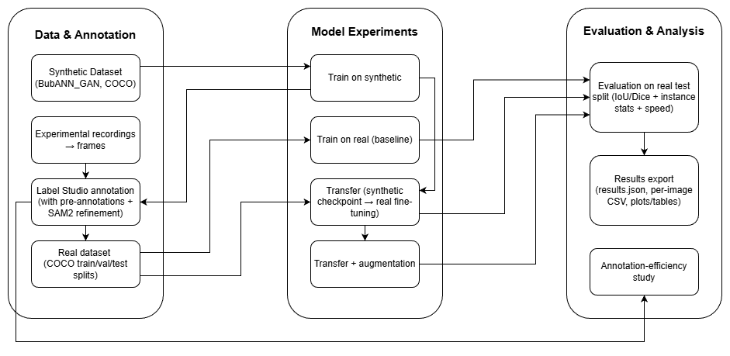
Workflow map
Data
Training regimes
Evaluation
Annotation study
Figure 4: End-to-end research workflow adopted
Notes:
This slide summarizes the full workflow: unify synthetic and real data, run a controlled grid of training regimes, evaluate with metrics that reflect both segmentation quality and measurement reliability, and finally quantify how much model assistance reduces annotation time.

Slide 6
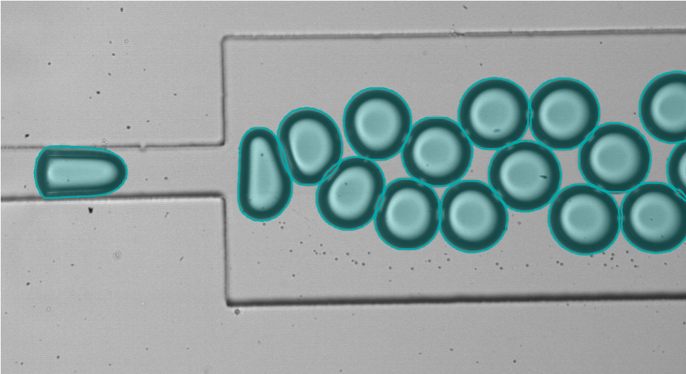
Data & labels
Real experimental dataset: 243 annotated images
fixed test set: 25 images (held out for final evaluation)
Synthetic dataset: BubANN_GAN used for pretraining
Supervision: instance masks (one mask per bubble), exported to COCO-style format
Standardization: all images resized to a common input resolution (e.g., 512×512) for fair comparisons
Figure 5: Real image with Ground Truth instance mask overlay
Notes:
This work relies on a small but carefully annotated real dataset, plus a large synthetic dataset for pretraining. Labels are instance-level and stored in COCO format, and I keep preprocessing and resolution consistent so differences come from the training regime/model rather than data handling.

Slide 7
Experimental design: 12 runs
Model family: Mask R-CNN (instance segmentation, FPN)
Backbones compared (×3):
ResNet-50 + FPN
ResNet-50 + FPN v2
ResNet-101 + FPN
Training regimes (×4):
Synthetic-only
Real-only
Transfer: Synthetic → Real fine-tuning
Transfer + Augmentation
Total: 3 × 4 = 12 experiments, same preprocessing and evaluation protocol
Reproducible runner: YAML configs → same pipeline for all runs
Training control: max 50 epochs, early stopping patience = 7
Notes:
I keep the model family fixed and vary only backbone capacity and the training regime. This gives a clean comparison: how much comes from architecture vs. data regime, and whether synthetic-to-real transfer consistently helps.
I chose Mask R-CNN with FPN because it’s a strong, standard instance segmentation baseline and handles multi-scale objects. Comparing ResNet-50, ResNet-50 v2, and ResNet-101 lets me quantify the accuracy–speed trade-off under the same framework.
I built a reproducible experiment runner driven by YAML configs, so every run is defined by parameters rather than manual changes. Training is capped at 50 epochs, with early stopping using patience 7 based on validation performance, so comparisons are consistent and we avoid over-training.

Slide 8
Synthetic → Real transfer learning
Step 1 - Pretrain on synthetic: learn generic “bubble-like” features from BubANN_GAN
Step 2 - Fine-tune on real: adapt to experimental imaging conditions (noise, blur, illumination)
Stabilization tricks (to avoid overfitting / forgetting):
Backbone freeze (3 epochs): warm-start to stabilize transfer and align heads before full fine-tuning.
Then unfreeze with a smaller backbone learning rate (backbone LR factor)
Controlled comparison: same input resolution and evaluation across regimes
Notes:
The key methodological idea is to use synthetic data to learn robust instance segmentation priors, then fine-tune on a small real dataset. To make fine-tuning stable, I control the backbone update, freezing it first and then training it with a reduced learning rate, so the model adapts without destroying useful representations.

Slide 9
Evaluation
Train / Val (model selection)
mAP@[0.50:0.95] (COCO AP)
used to pick best checkpoint
Test (final reporting)
Union-mask overlap: Dice / IoU / Precision / Recall / F1
Measurement indicators: ΔN and |ΔN|, mean/median area
Runtime: FPS
Why dual-view: good overlap can still mean wrong count (split/merge).
Notes:
I evaluate in two layers because the goal is measurement. During training and validation, I use COCO-style mAP@[0.50:0.95] to select the checkpoint, this is standard and stable for model selection. But for the final test results, I report metrics aligned with the application: union-mask overlap tells me whether the bubble region is correct overall, while ΔN and |ΔN| capture counting reliability, and area statistics reflect measurement quality. I also report FPS because runtime matters in practice. Threshold settings are fixed across runs for fairness and are shown in the backup.

Slide 10
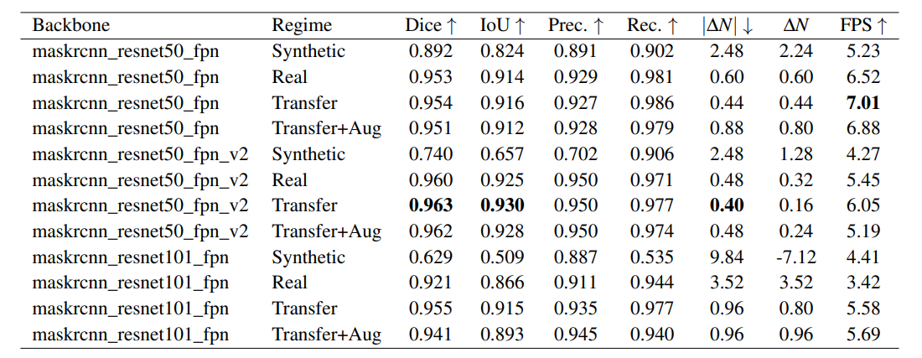
Results overview
Table 1: Main comparison of the 12 experiments on the held-out real experimental test split (25 images)
Real-only training already achieves high overlap, but instance stability differs across backbones.
Synthetic-only underperforms on real images (domain gap), especially for ResNet-101.
Best overall in this grid: ResNet-50-FPN v2 + Transfer → Dice 0.963, IoU 0.930, |ΔN| 0.40.
Notes:
This slide summarizes the whole experimental grid: 3 backbones × 4 training regimes, all evaluated on the same 25-image real test split with fixed thresholds. The main message is: training on real data already gives strong foreground overlap, but synthetic-only shows a clear domain gap. Transfer learning is the most consistently beneficial regime, and the best overall configuration is ResNet-50-FPN v2 with transfer, which combines the highest Dice/IoU with the lowest mean absolute count error.

Slide 11
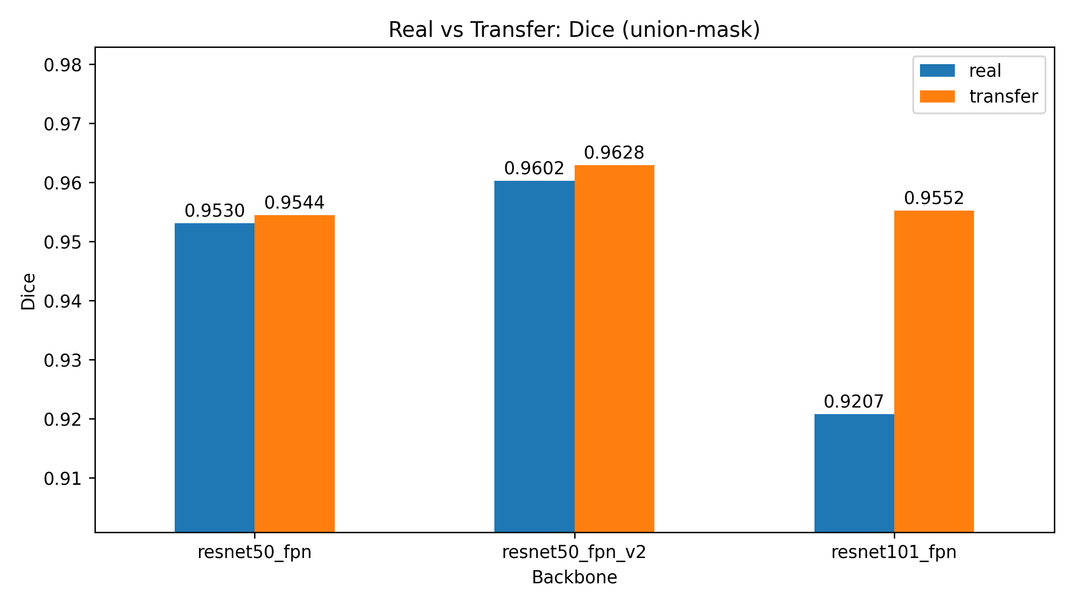
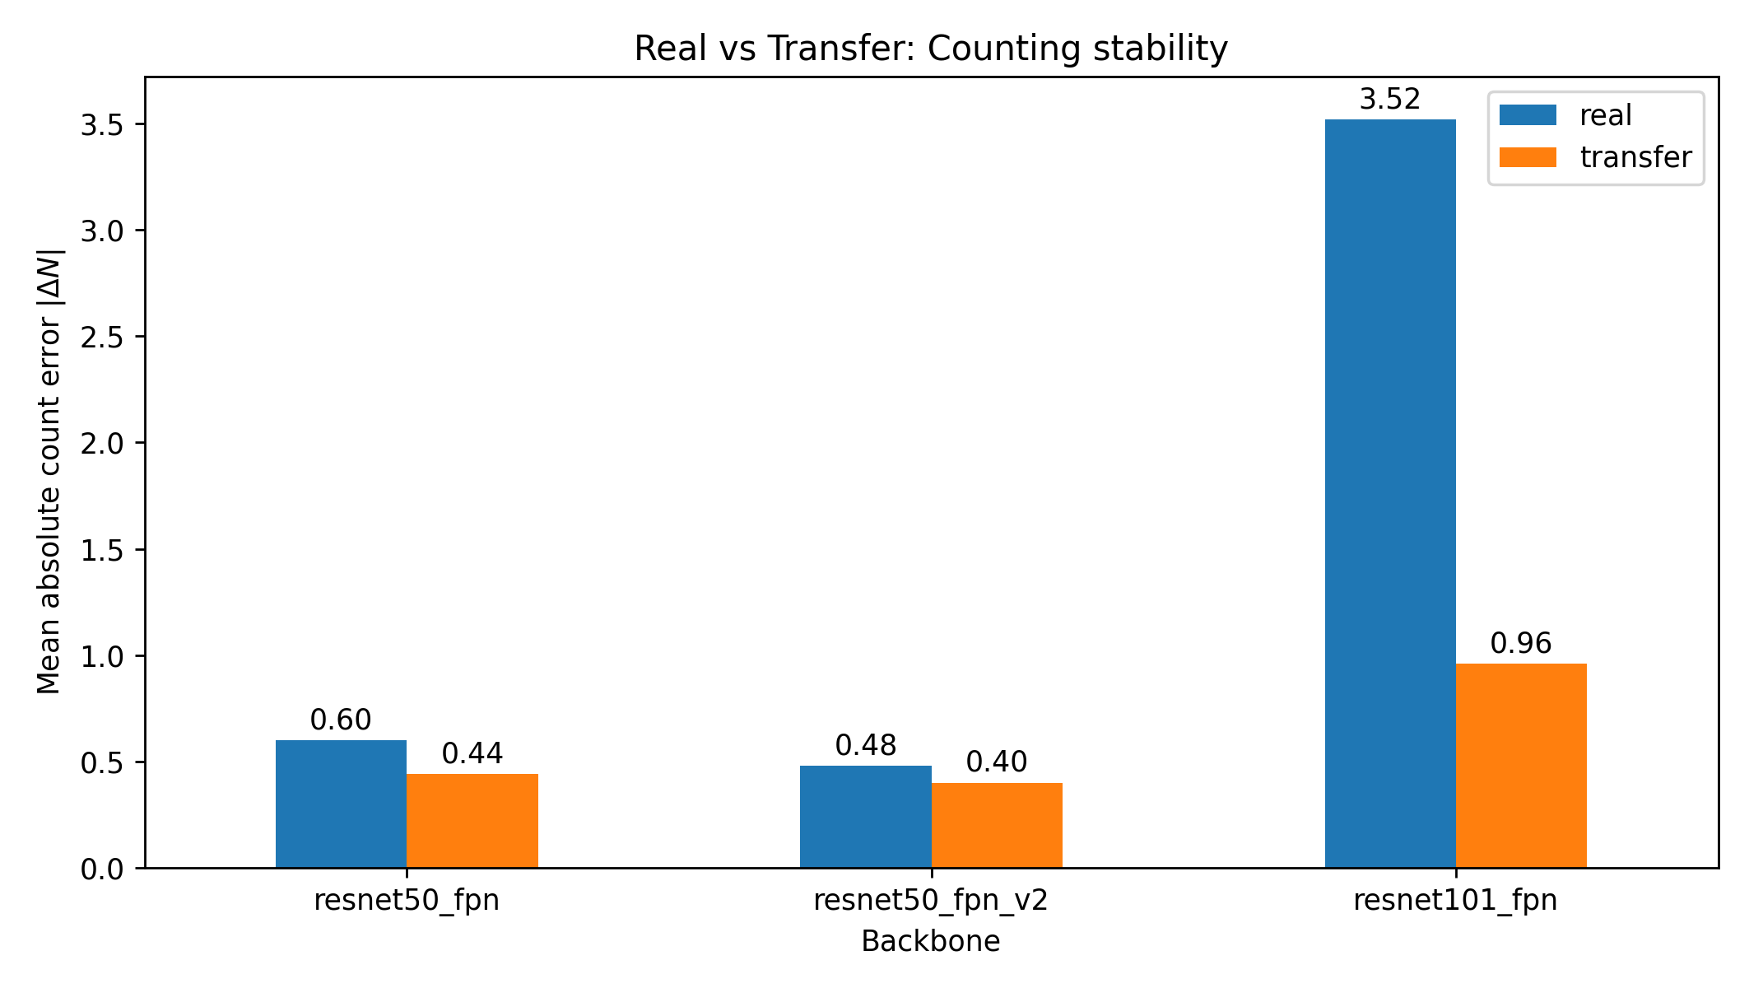
Transfer learning impact
ResNet-50 backbones: small overlap gains, clearer improvement in counting stability
R50: Dice 0.9530 → 0.9544, |ΔN| 0.60 → 0.44
R50 v2: Dice 0.9602 → 0.9628, |ΔN| 0.48 → 0.40
Largest benefit on ResNet-101: transfer fixes unstable instance predictions
Dice 0.9207 → 0.9552
|ΔN| 3.52 → 0.96
Bias reduction (ΔN closer to 0): R101 overcount +3.52 → +0.80
Takeaway: overlap is near a ceiling, so transfer shows up most in measurement-relevant metrics (|ΔN|, ΔN).
Figure 6: Effect of synthetic-to-real transfer learning on the real test split (Real vs. Transfer): mean Dice (union-mask) across backbones
Figure 7: Effect of synthetic-to-real transfer learning on the real test split (Real vs. Transfer): mean absolute count error |∆N| across backbones
Notes:
Here I isolate the effect of transfer by comparing Real-only vs Transfer for each backbone. For the two ResNet-50 variants, Dice changes are small because overlap is already high, but transfer still reduces count error. The big story is ResNet-101: training from scratch on limited real labels led to systematic over-detection, and synthetic initialization dramatically stabilizes instance predictions. Dice rises and both |ΔN| and ΔN drop sharply.

Slide 12
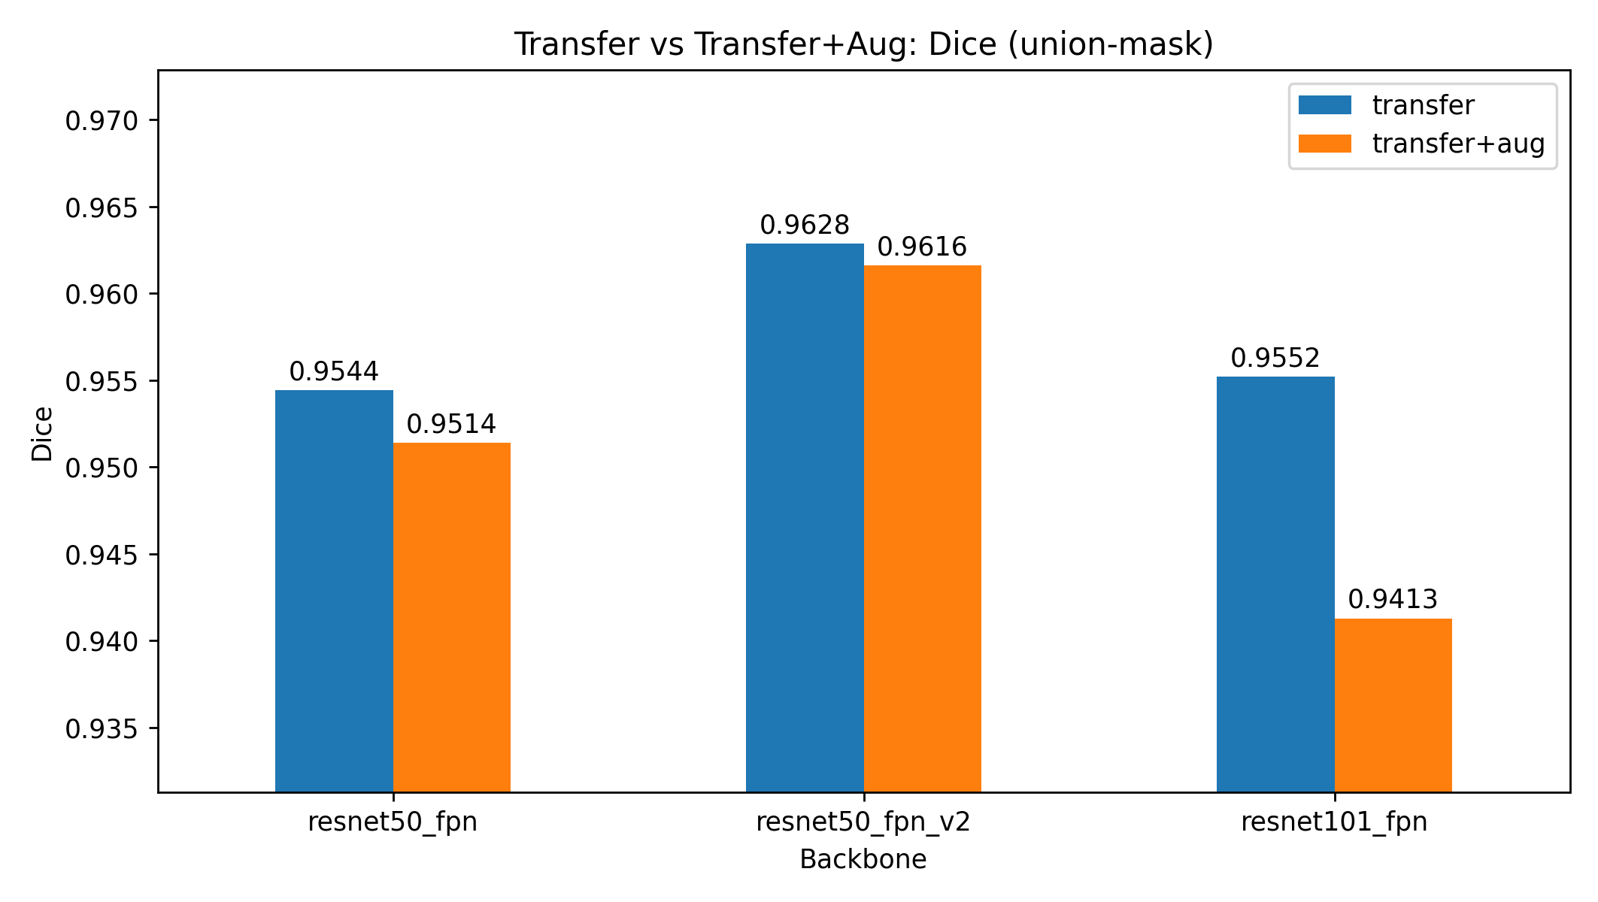
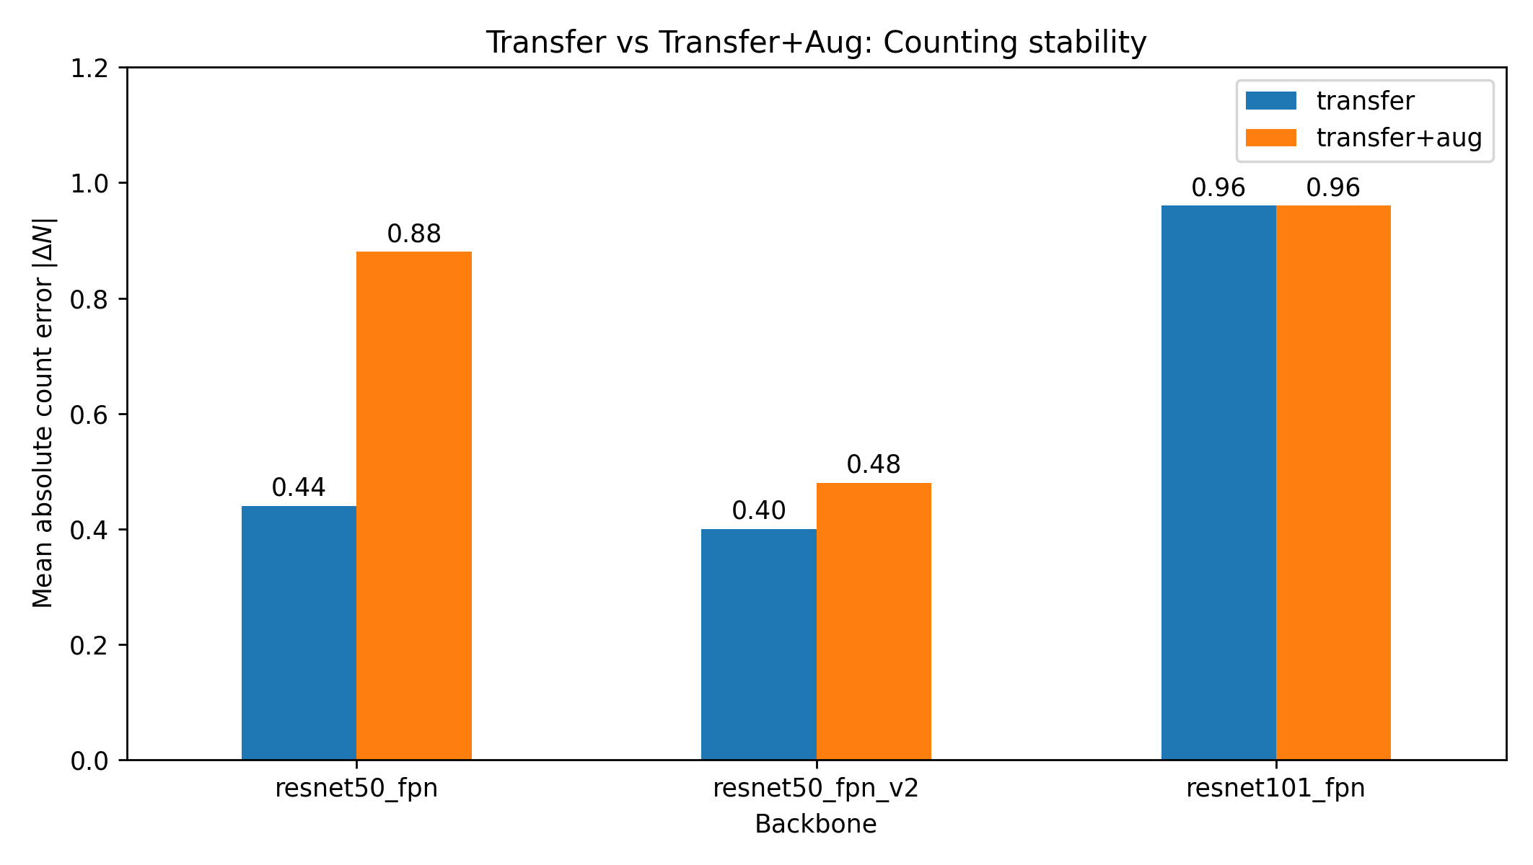
Does augmentation improve transfer learning?
Figure 8: Effect of augmentation during transfer learning (Transfer vs. Transfer+Aug): mean Dice (union-mask) across backbones
Figure 9: Effect of augmentation during transfer learning (Transfer vs. Transfer+Aug): mean absolute count error |∆N| across backbones
On this test split, augmentation did not improve mean overlap and often worsened counting.
Likely reasons: (1) high-variance estimate (small test set) and (2) policy mismatch: augmentations that don’t match real acquisition act like distribution shift during training.
Implication: augmentation should be physics/acquisition-informed and validated on a larger, more diverse evaluation split.
Notes:
I tested whether turning on augmentation during the real fine-tuning stage improves robustness. Under the same thresholds and split, it doesn’t improve average Dice and can degrade counting stability, especially for ResNet-50-FPN. For ResNet-101 it even reduces Dice noticeably. So, in this dataset and setup, transfer learning alone is the safer choice; augmentation might need different types/strengths or a larger real dataset to be beneficial.
Augmentation didn’t show a consistent improvement here, but this result has two important caveats. First, the real fine-tuning set is limited and the held-out test split has only 25 images, so the measured mean and tail metrics have high variance, just a few difficult frames can dominate the apparent effect. Second, augmentation only improves robustness when the transformations reflect realistic variability of the acquisition process. If the policy is even partially mismatche, like photometric or geometric changes that don’t occur in the experiment, it effectively introduces a distribution shift during training and can hurt performance under a fixed test protocol. So, augmentation needs to be guided by the imaging physics and validated with a larger, more diverse evaluation split.

Slide 13
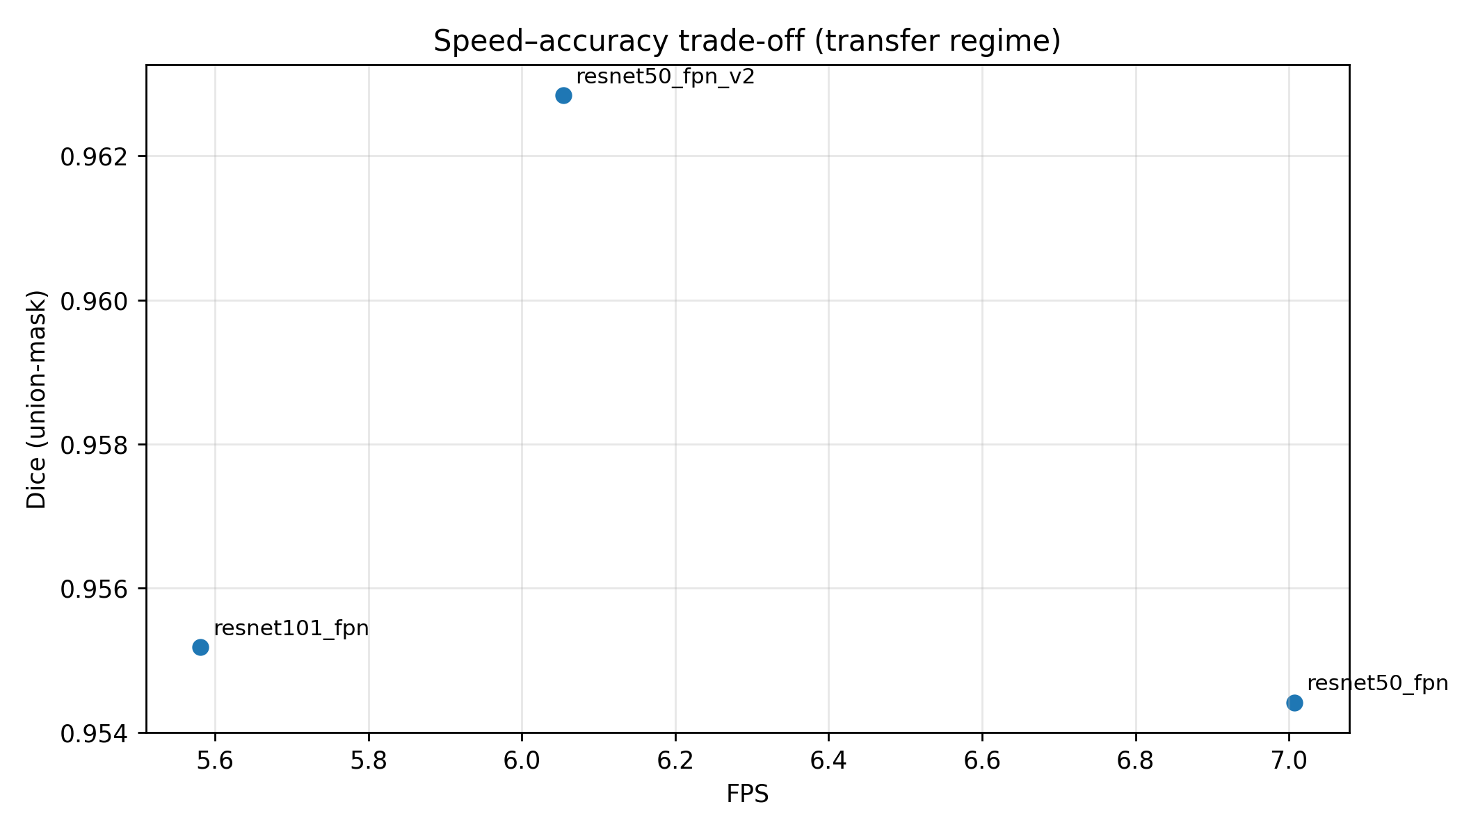
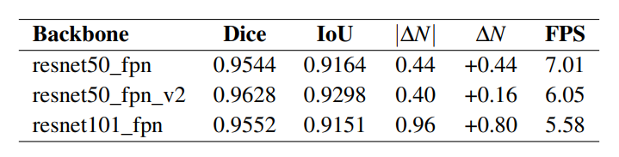
Speed vs accuracy
Table 2: Backbone capacity versus inference throughput in the transfer regime (real test).
Figure 10: Speed–accuracy trade-off in the transfer regime (Dice versus FPS)
Fastest: ResNet-50-FPN (Transfer) ≈ 7.01 FPS
Best overall compromise: ResNet-50-FPN v2 (Transfer) ≈ 6.05 FPS with top accuracy
Slowest: ResNet-101-FPN (Transfer) ≈ 3.53 FPS (higher cost for limited benefit here)
Notes:
Besides accuracy, runtime matters for practical use. Here I compare mean inference time and FPS under the same setup. ResNet-50 is the fastest, ResNet-50 v2 is slightly slower but gives the best overall accuracy in our results, and ResNet-101 is about half the throughput. So, if we need real-time or high-throughput processing, R50 is attractive; if we want the best balance of accuracy and speed, R50 v2 with transfer is the recommended choice for this dataset.

Slide 14
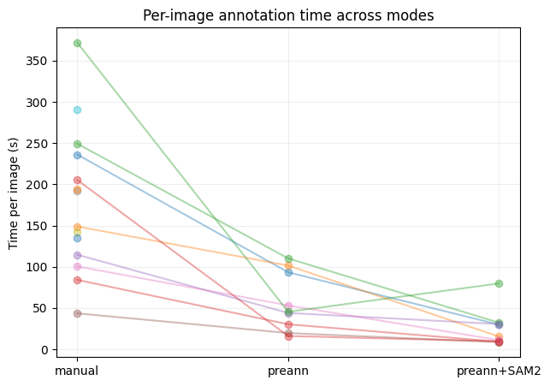
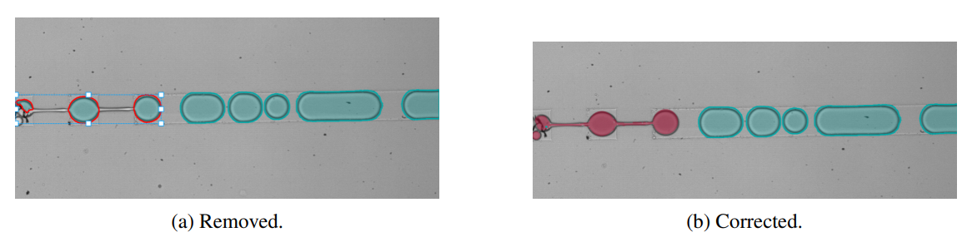
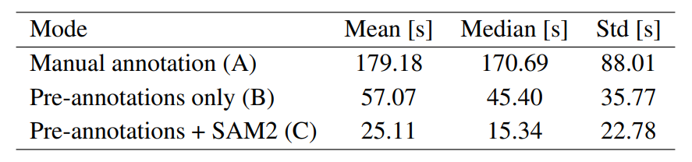
Annotation efficiency: manual vs. model-assisted workflows
Three annotation modes (in Label Studio):
Manual polygon masks
Correct pre-annotations (Mask R-CNN synthetic model)
Pre-annotations + SAM2 refinement
Time per bubble: 94.49 s → 3.20 s (≈ 30× faster)
Time per image (mean): ~179 s → 25 s (manual → SAM2-assisted)
Takeaway: assistance shifts the effort from “draw everything” to correct/refine; hardest frames still need human judgment.
Figure 13: Annotation time per image across the three annotation modes.
Table 4: Mean, median, and standard deviation of annotation time per image for each mode
Figure 14: Correction examples: removal of incorrect instances, and final corrected annotation
Notes:
To address the annotation bottleneck, I compared three workflows inside Label Studio: fully manual, correcting pre-annotations generated by a synthetic-trained Mask R-CNN, and adding interactive refinement using SAM2. The key result is the reduction in labeling time from about 94 seconds per bubble to about 3.2 seconds per bubble, roughly a 30× speedup, while still allowing manual control on difficult cases. In practice, the model gets many instances close enough that the task becomes correction rather than drawing from scratch, and SAM2 makes boundary refinement much faster.

Slide 15
Answers to Research Questions
RQ1 - How do instance segmentation models perform on real data?
Mask R-CNN variants achieve high overlap on the real test split.
ResNet-50-FPN v2 offers the best balance of accuracy and speed → Dice 0.9628, IoU 0.9303, |ΔN| 0.40.
RQ2 - Does synthetic→real transfer improve performance?
Yes: Transfer helps (especially stabilizes counting; biggest gain on R101)
RQ3 - Does model-assisted annotation reduce labeling effort?
Yes: Assisted workflows reduce time from 94.49 s/bubble → 3.20 s/bubble (~30×), while keeping human control for hard cases.
Overall, the proposed workflow meets the dissertation goals: strong baselines, validated transfer strategy, and scalable annotation.
Notes:
This slide closes the loop with the research questions. For RQ1, the baselines perform well on real data and we identify a practical best model. For RQ2, synthetic-to-real transfer consistently improves the metrics that matter for measurements, especially stabilizing ResNet-101. For RQ3, model assistance dramatically reduces annotation time (around 30x) which addresses the dataset bottleneck and supports scaling future data collection.

Slide 16
Limitations & next steps
Limitations
Small real dataset / small test split (25 images) → high variance
Coverage: limited operating conditions (lighting, density, optics)
Synthetic–real mismatch + annotation ambiguity in dense scenes
Next steps
Scale & diversify real data (more frames, broader conditions)
Acquisition-informed augmentation + validate on larger eval split
Iterative data engine: pre-annotate → refine (SAM2) → retrain (active loop)
Notes:
The main limitation is scale and coverage: the real dataset is limited and the test split is only 25 images, so metrics can have high variance and not cover all conditions.
Also, dense scenes are ambiguous and synthetic data doesn’t reproduce every imaging artifact.
The next steps directly address this: expand and diversify real data, redesign augmentation to match the acquisition process and validate on a broader split, and use an iterative loop, pre-annotations plus SAM2 refinement, to scale labeling efficiently and improve the hardest cases.

Slide 17

Thank You
Questions?

Slide 18
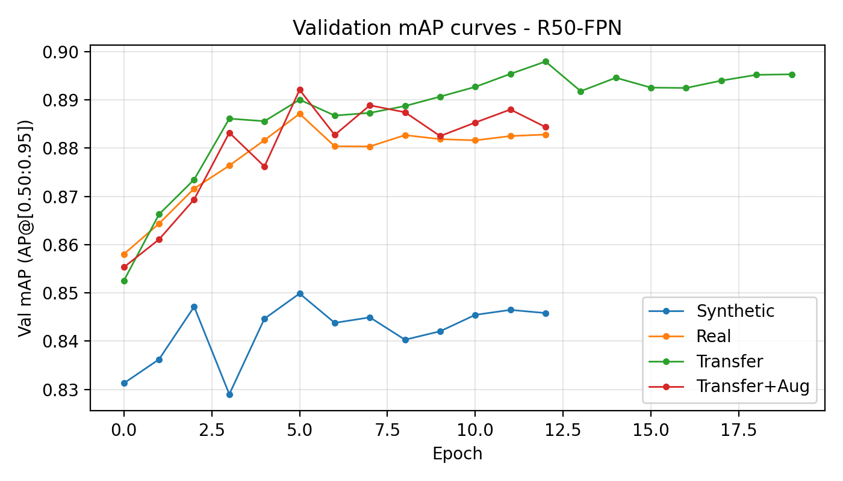
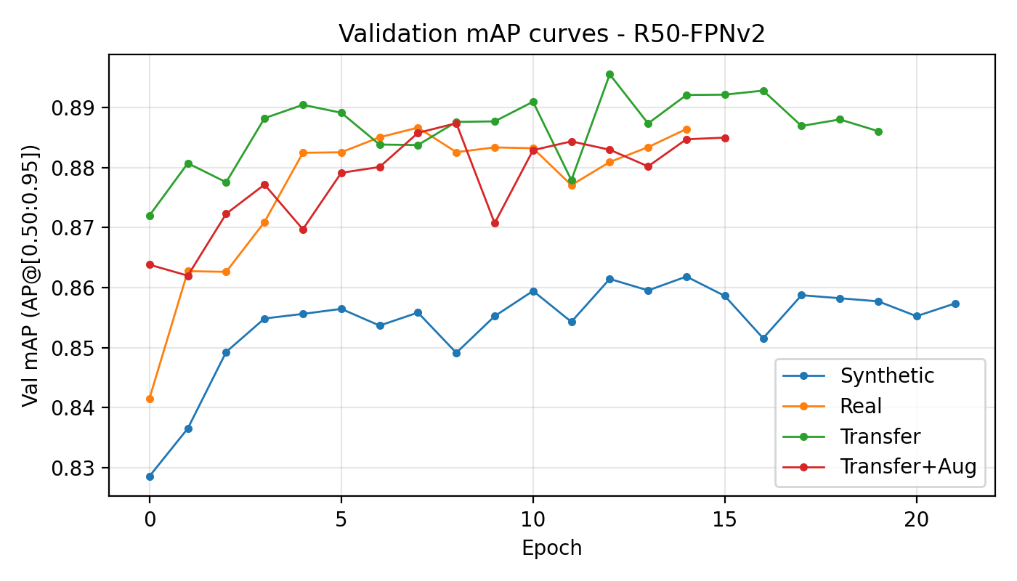
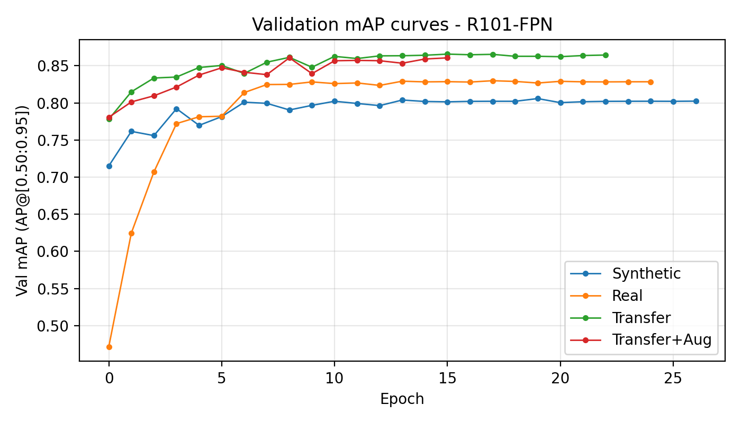
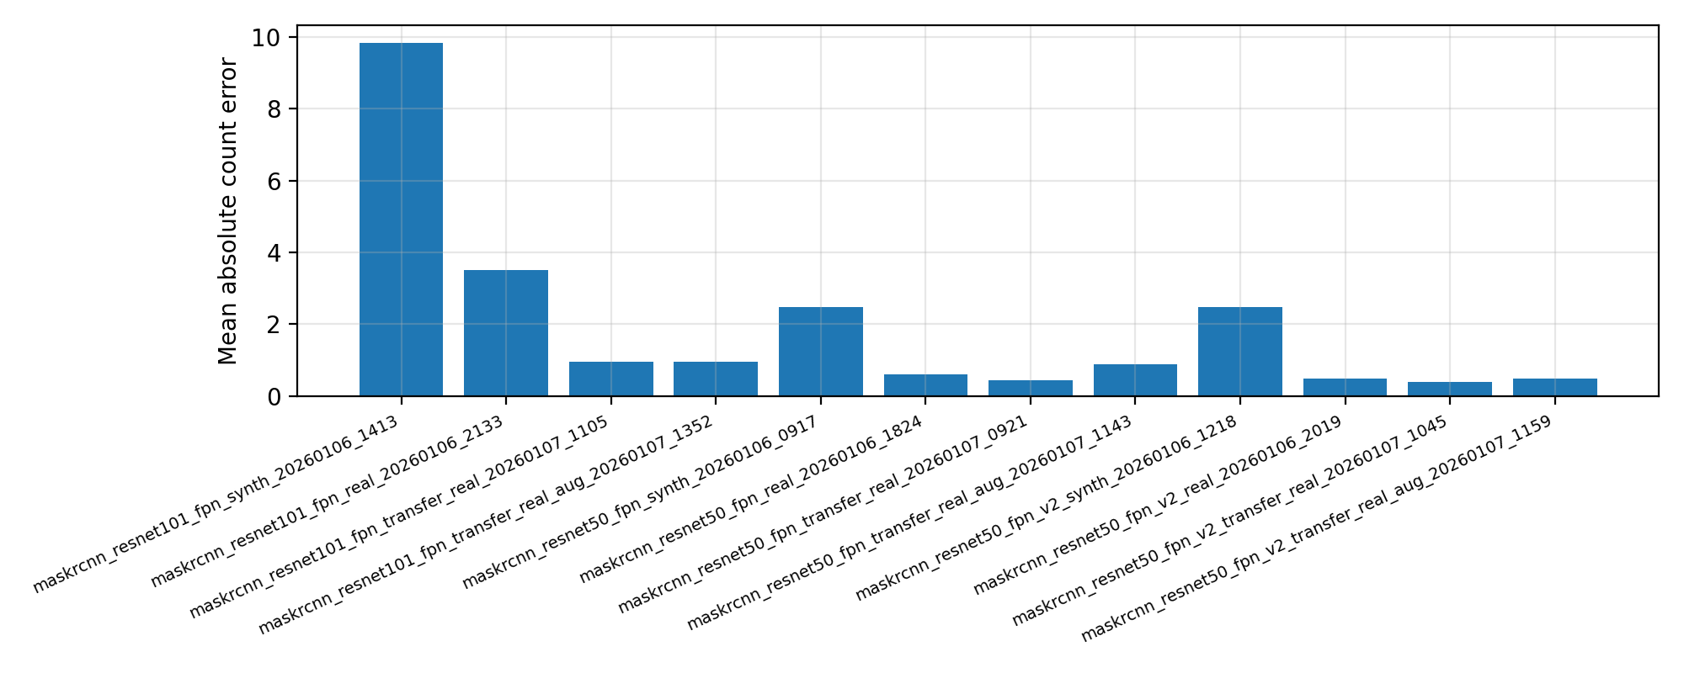
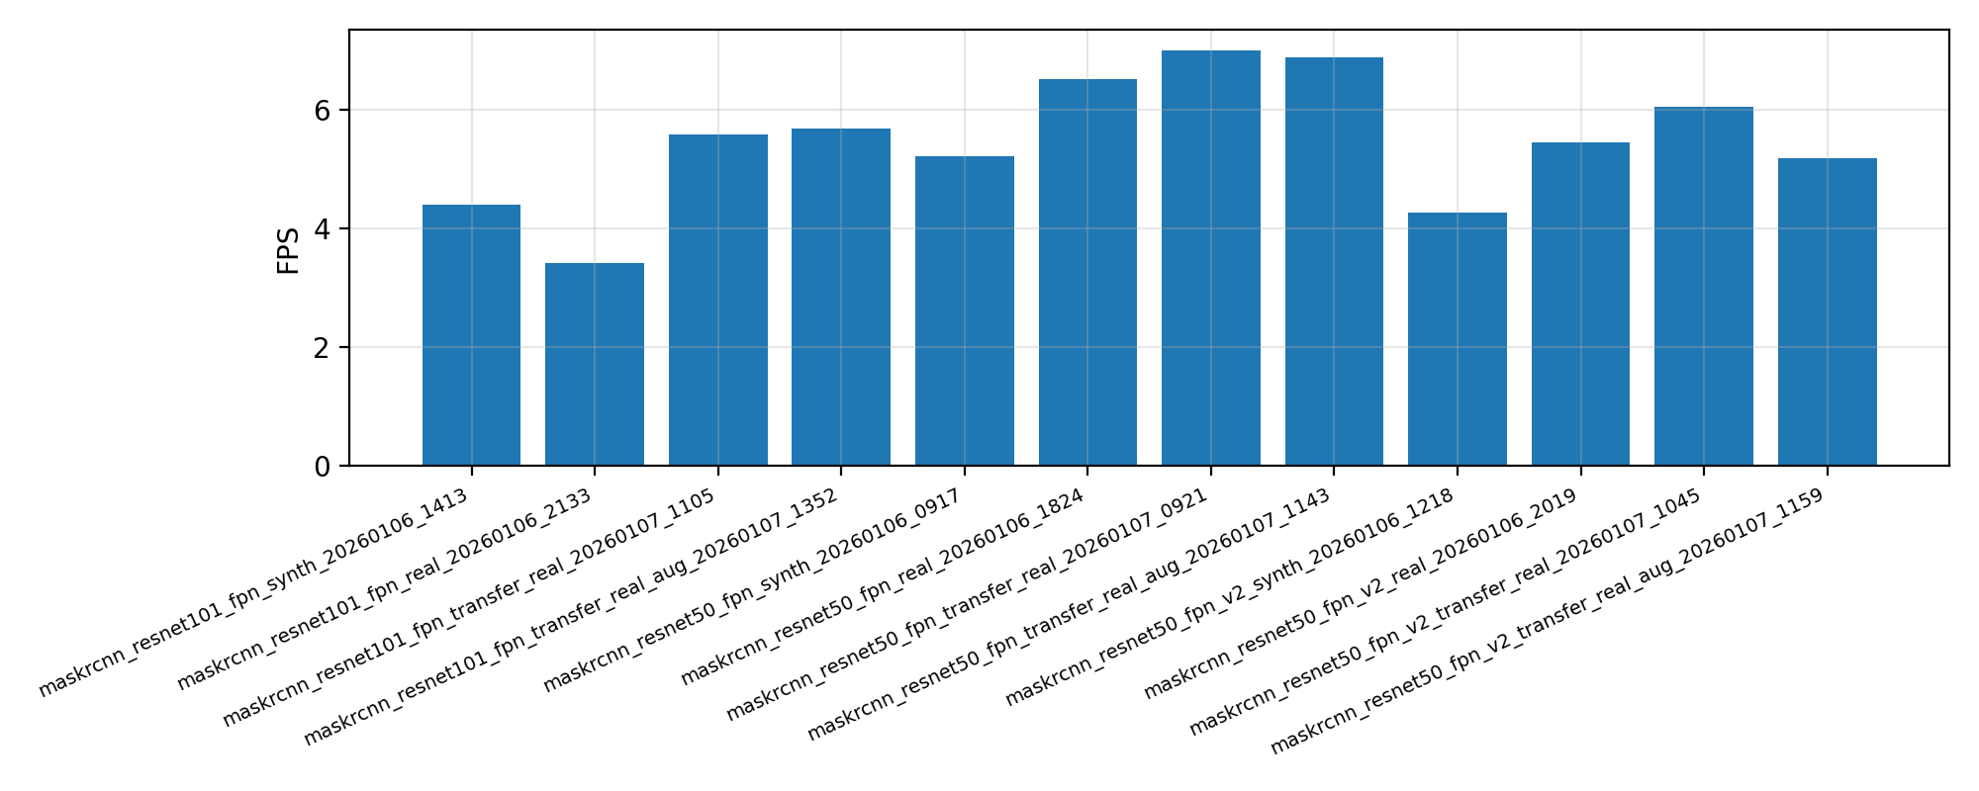
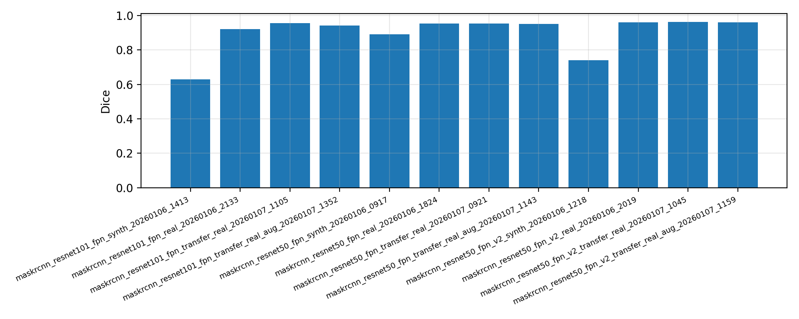
Train Validation + General Results

Slide 19
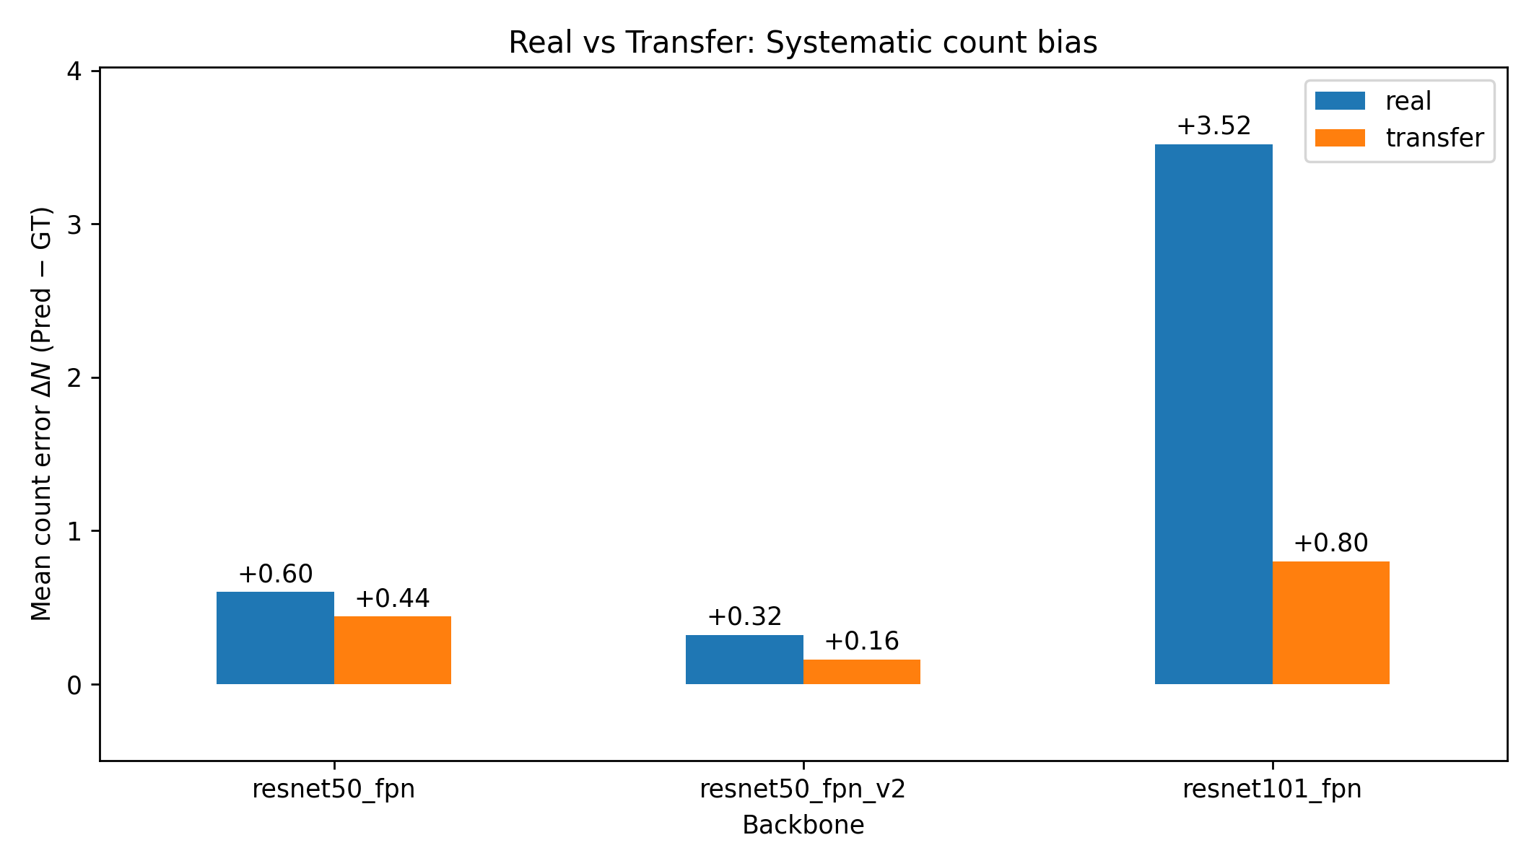
Transfer plots

Slide 20
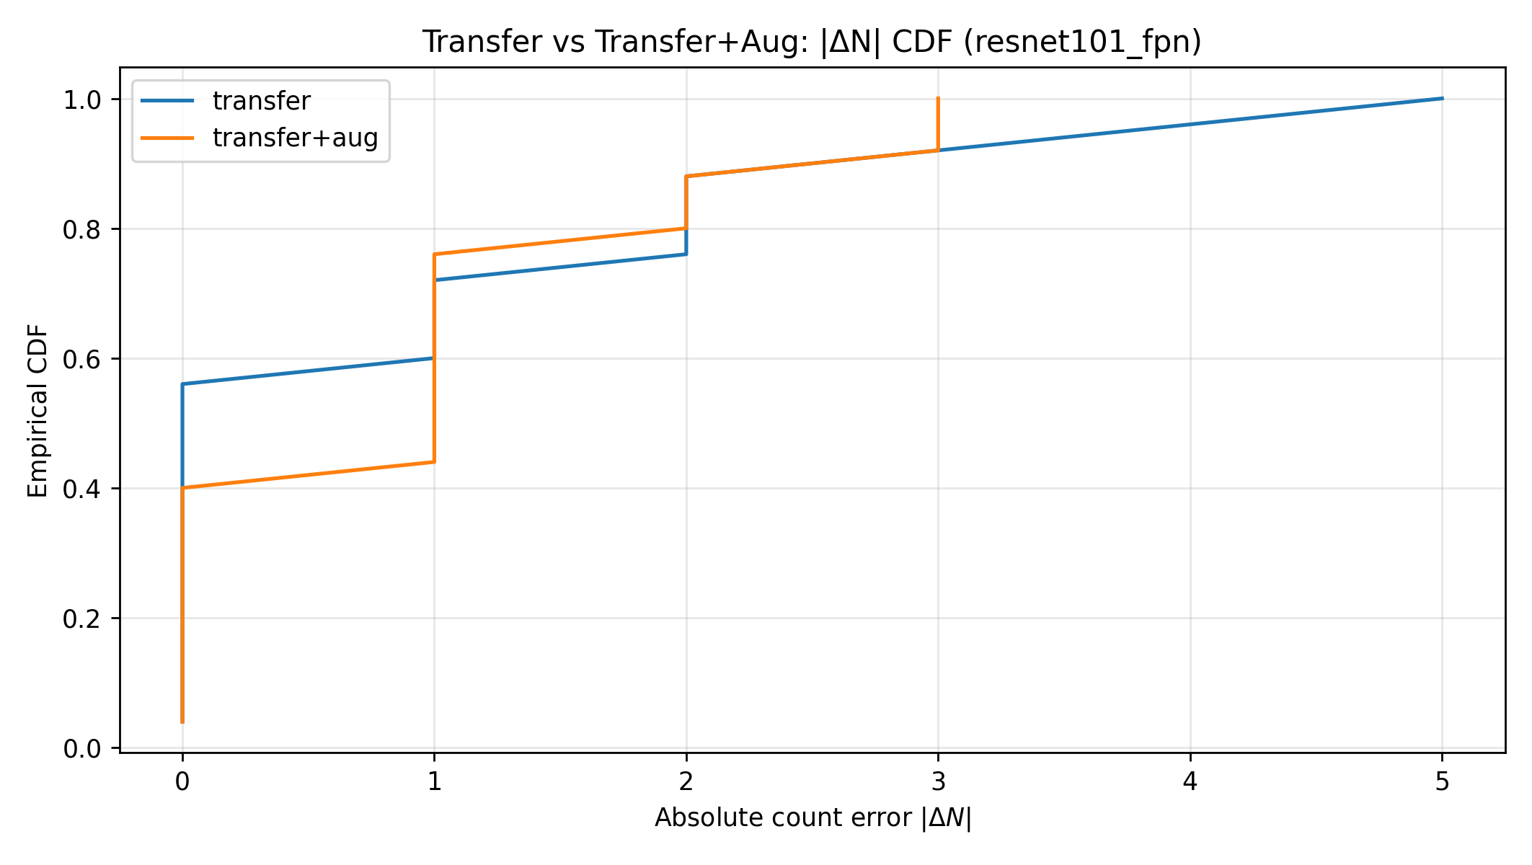
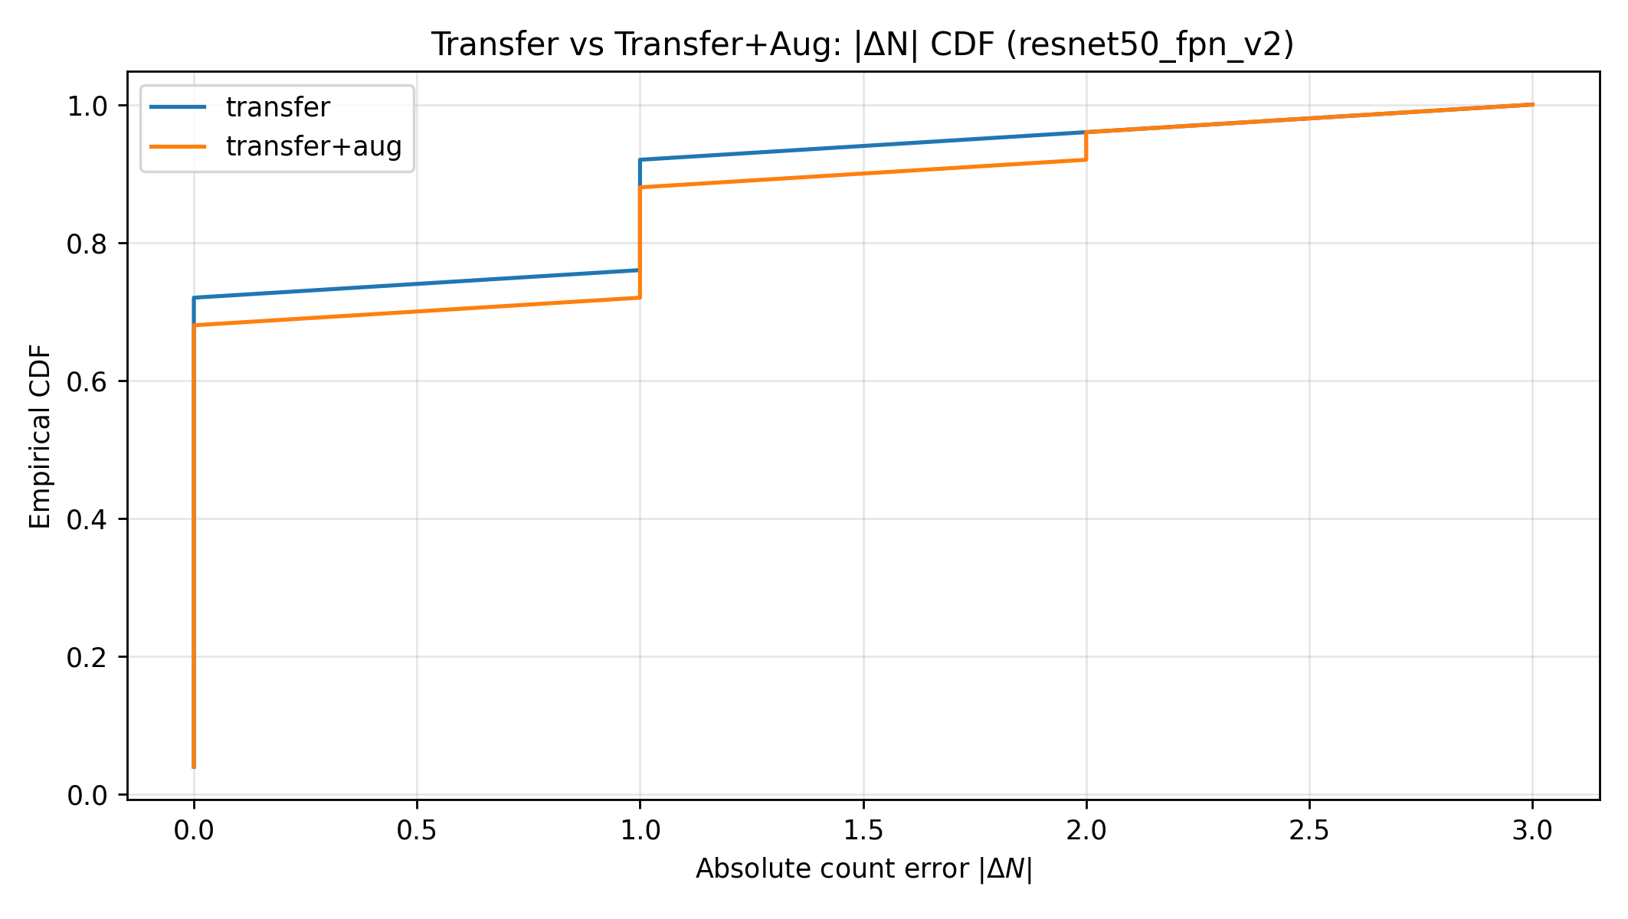
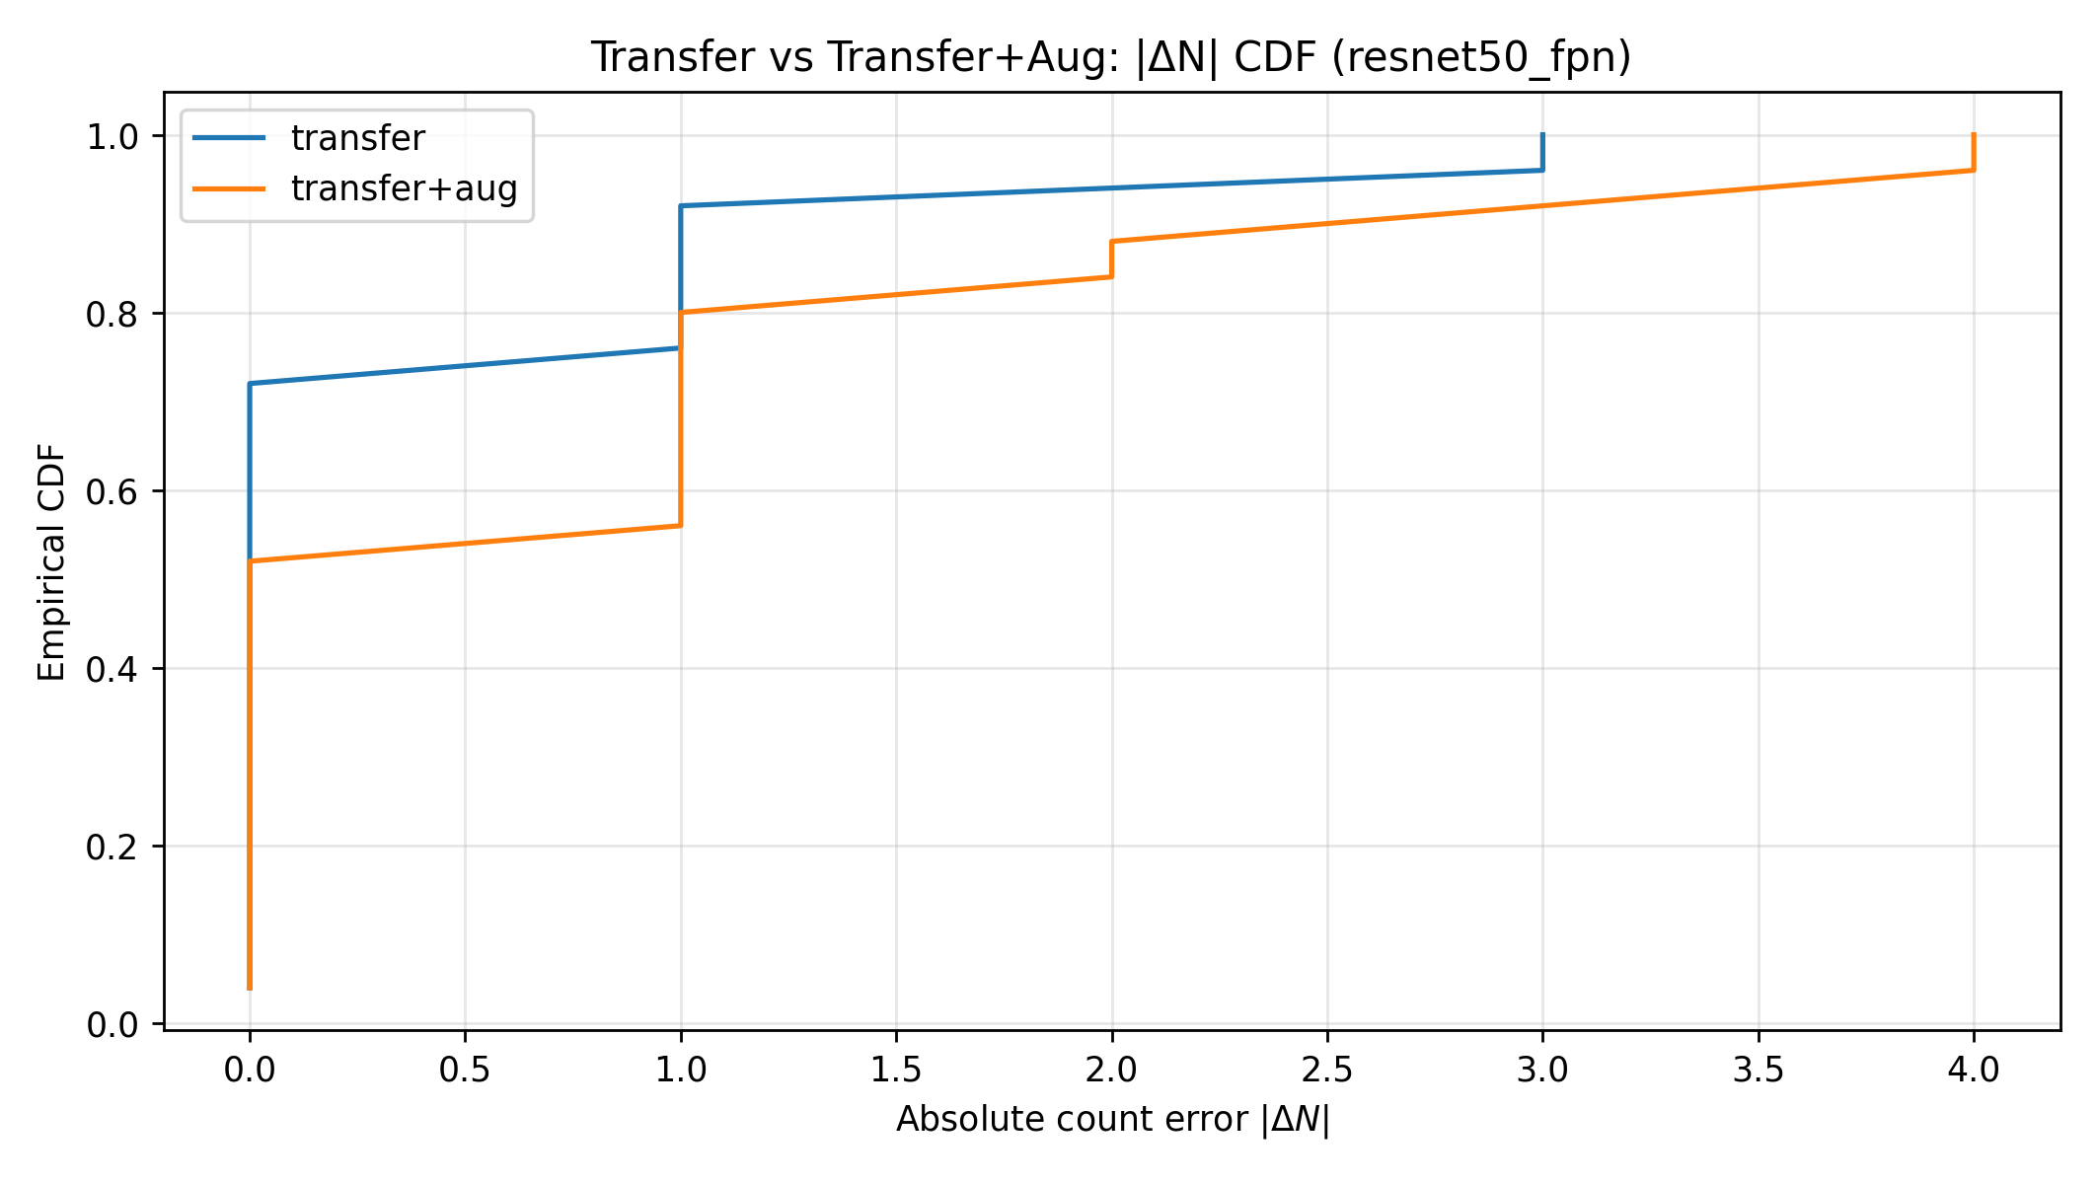
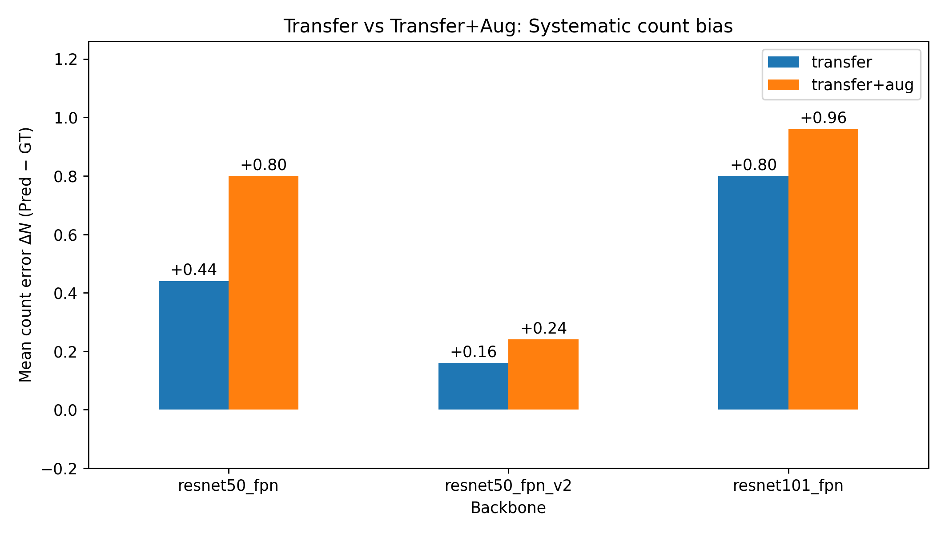
Augmentations plots + ECDF

Slide 21
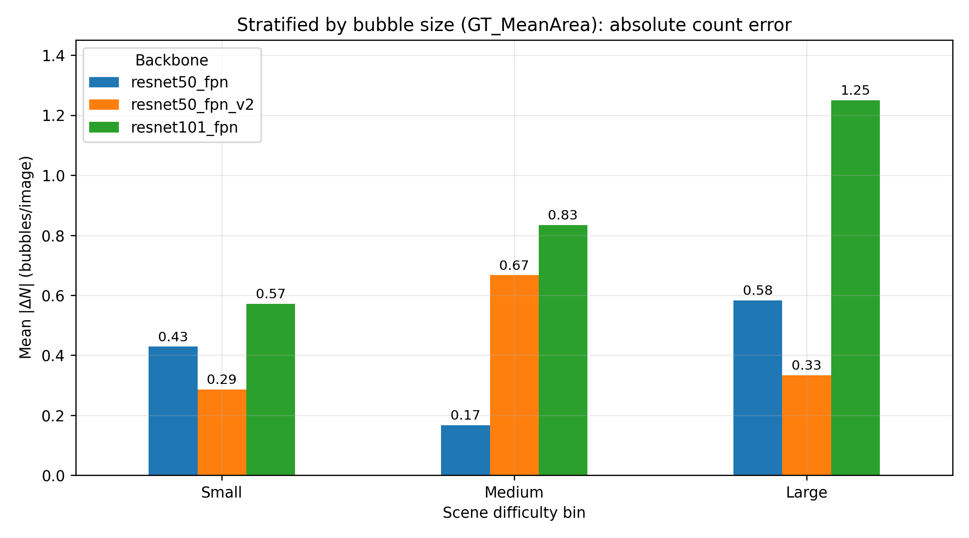
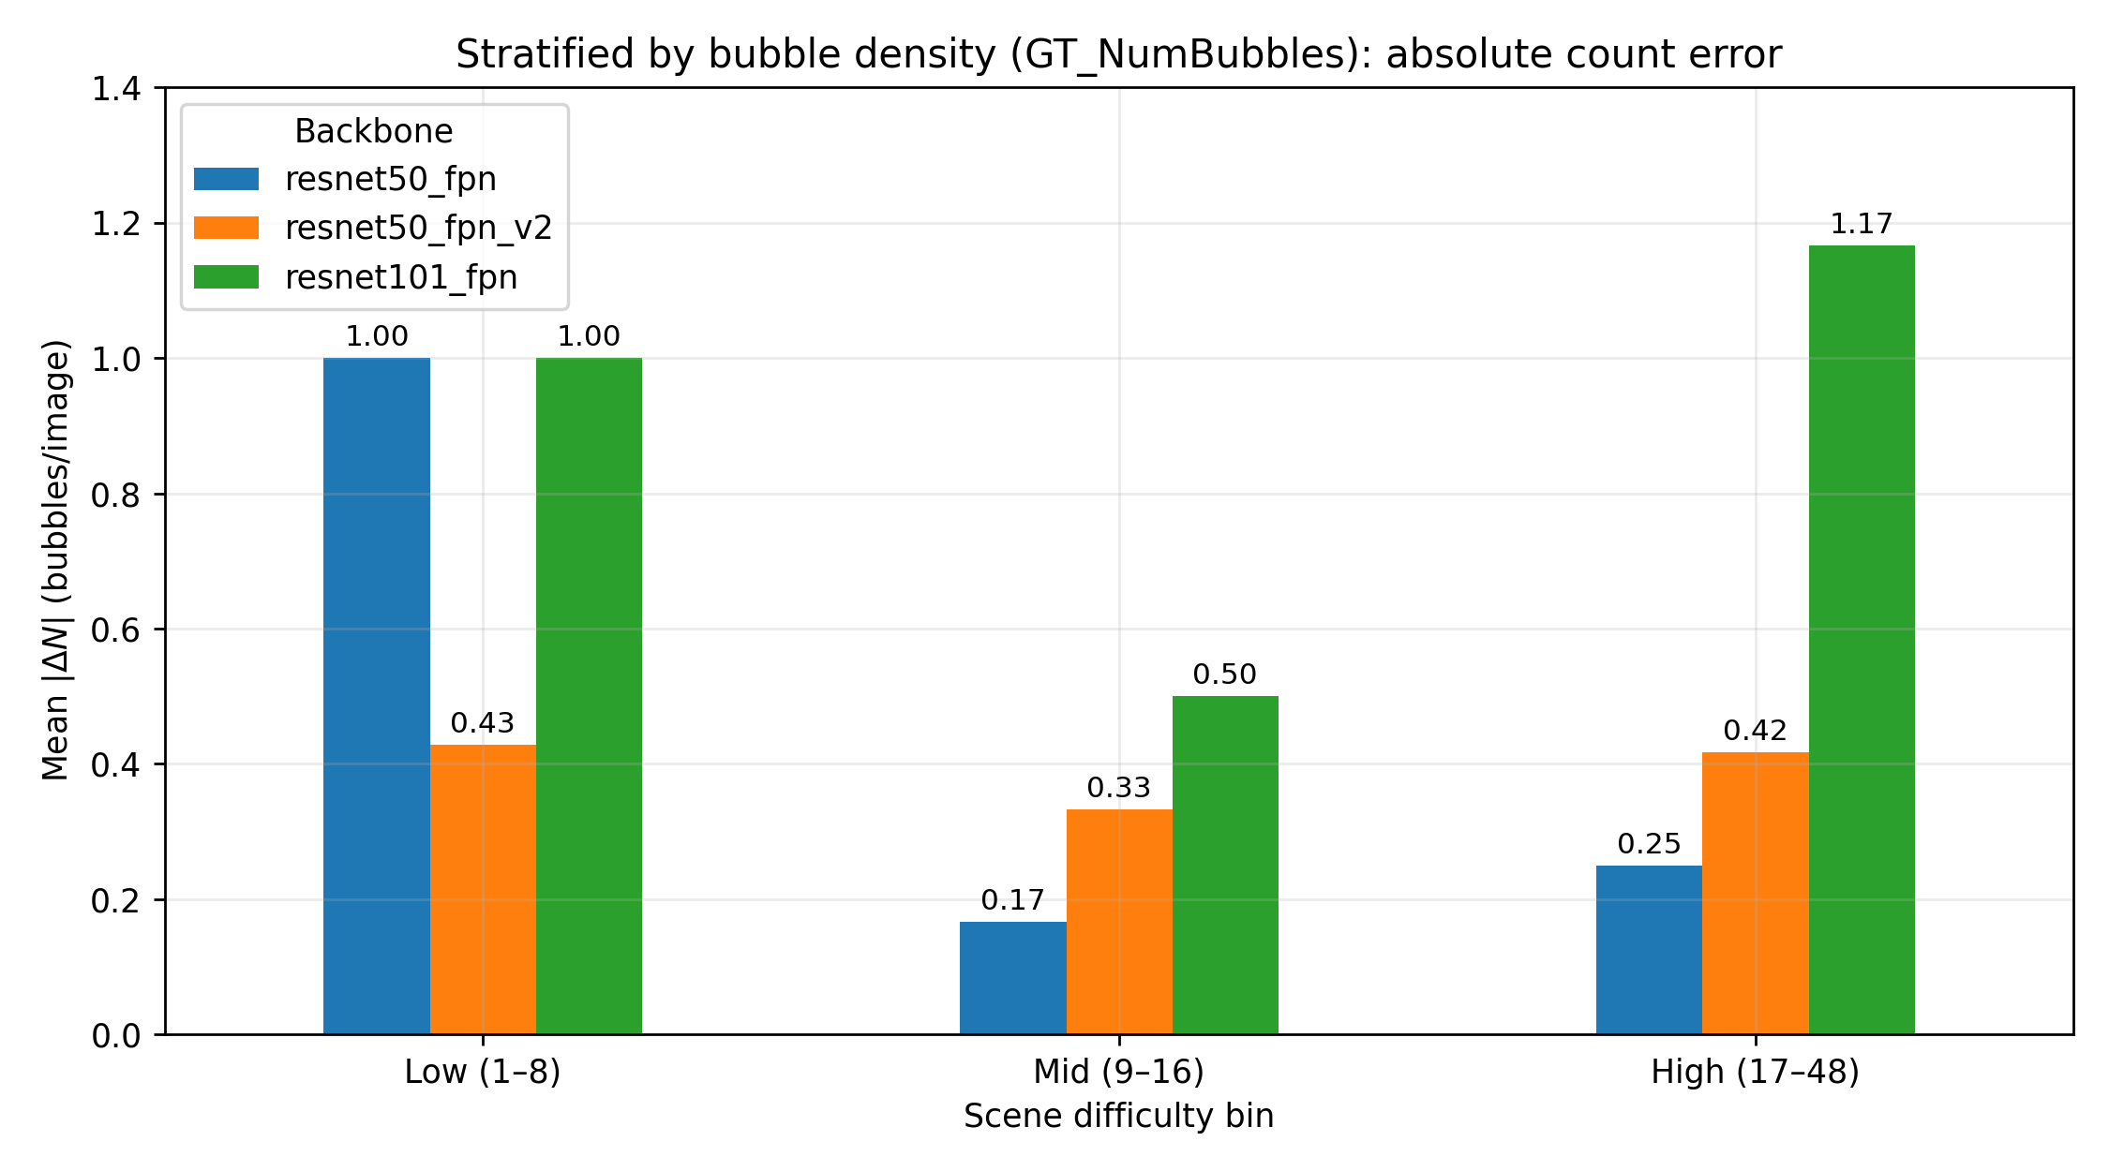
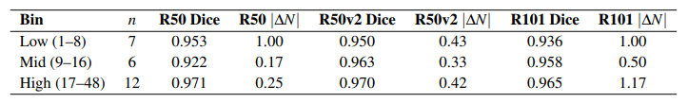
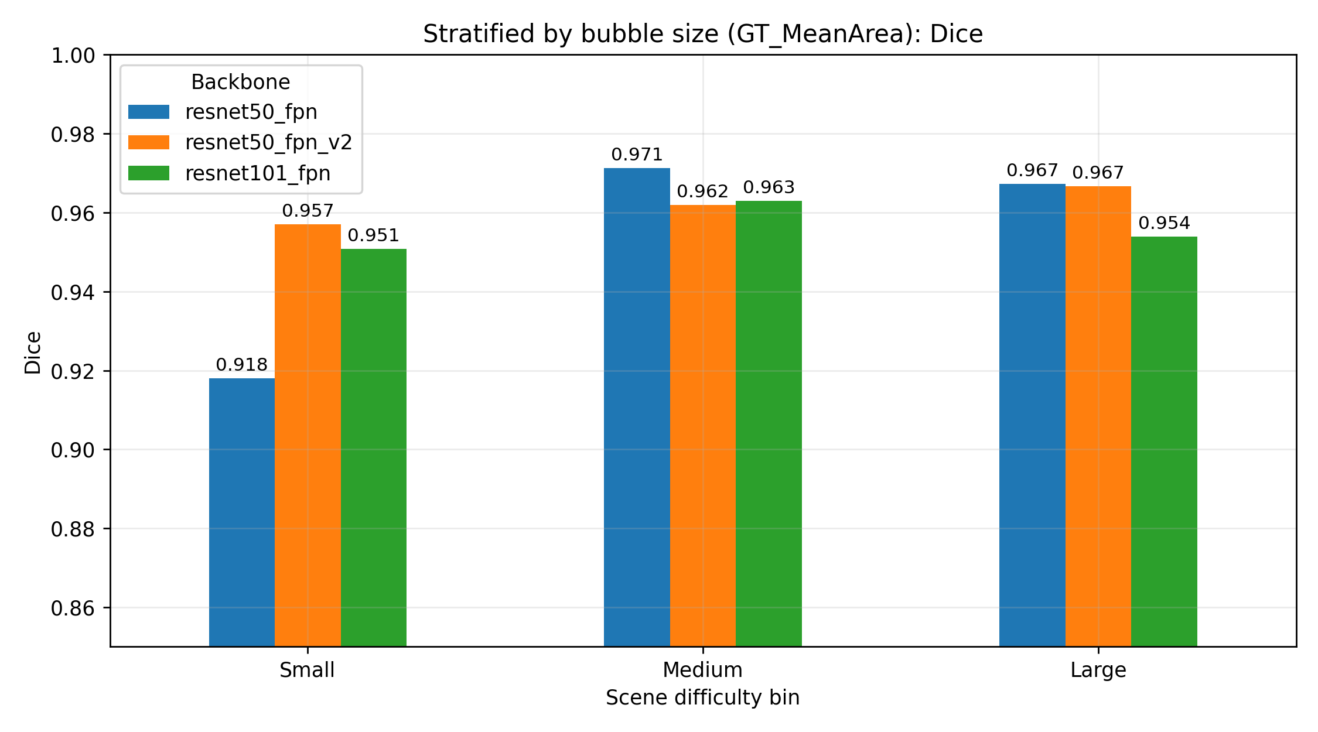
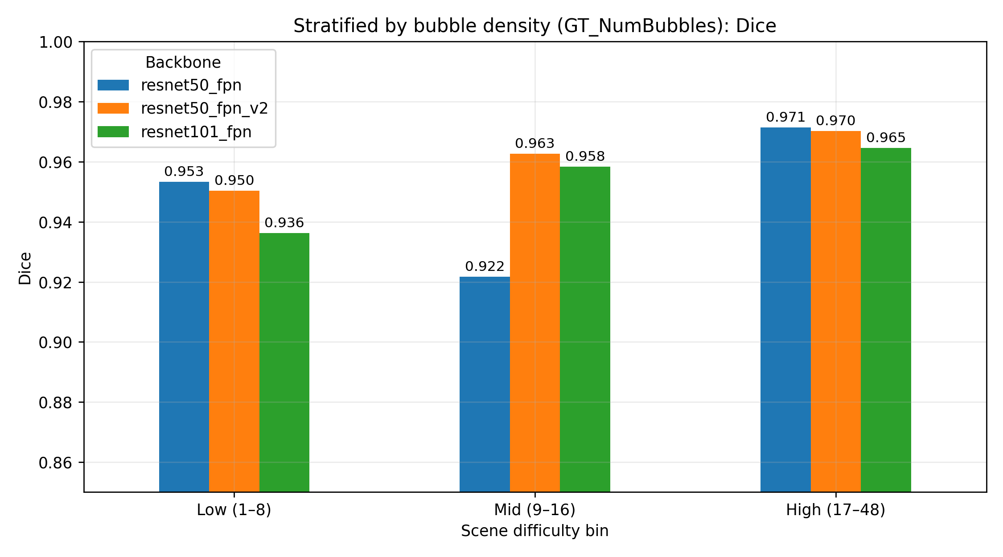
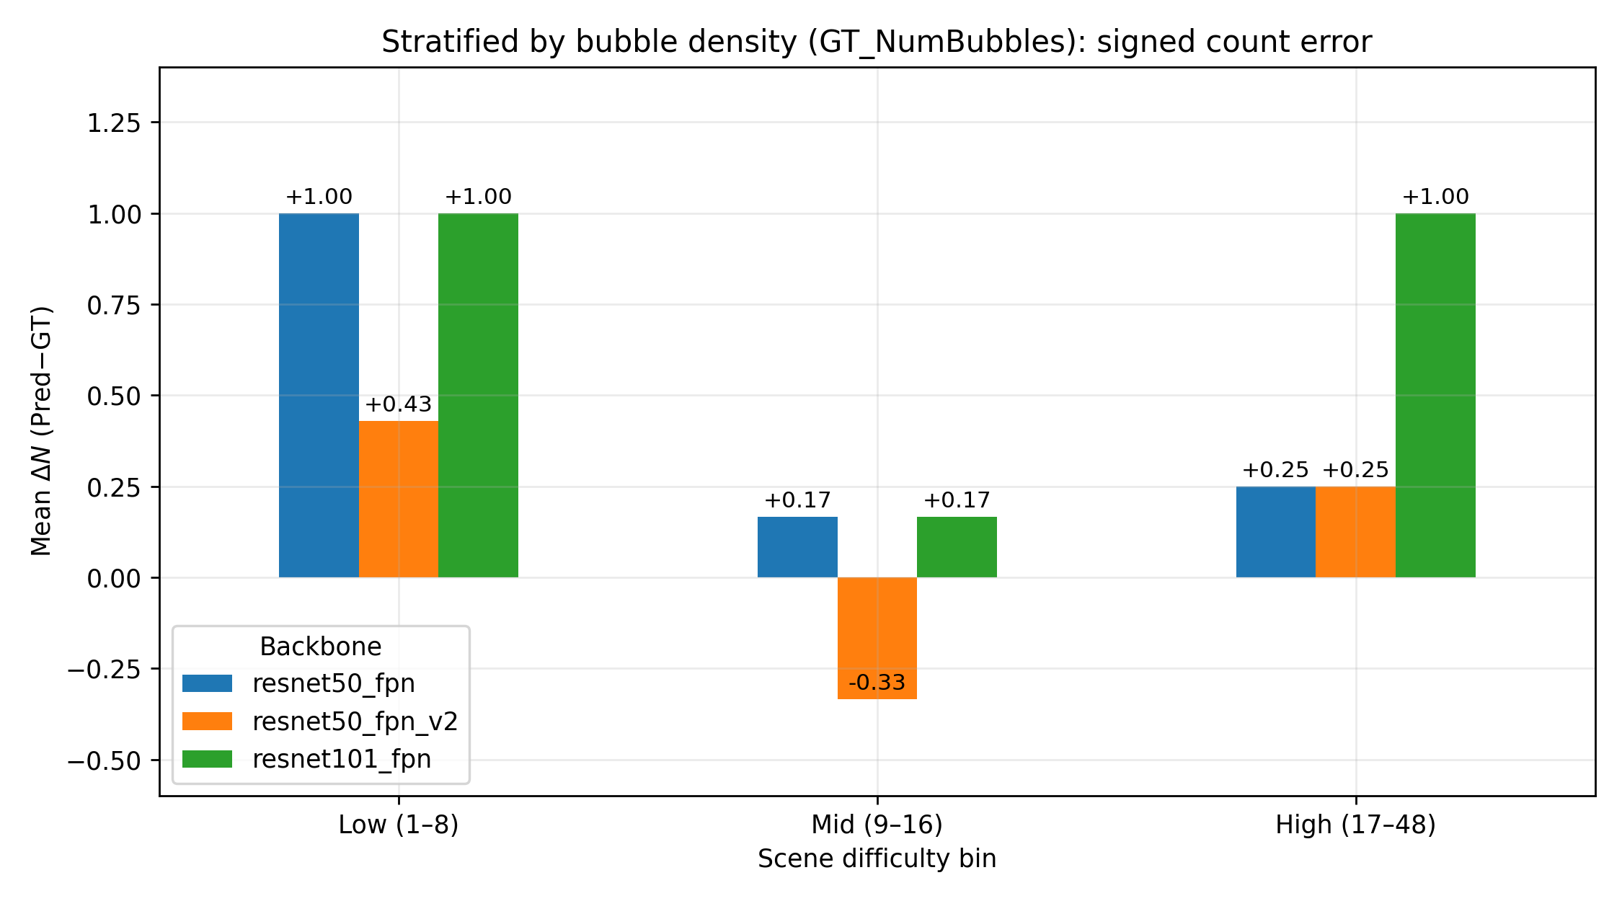
Stratification plots
Table 4: Stratified performance in the transfer regime by mean bubble density

Slide 22
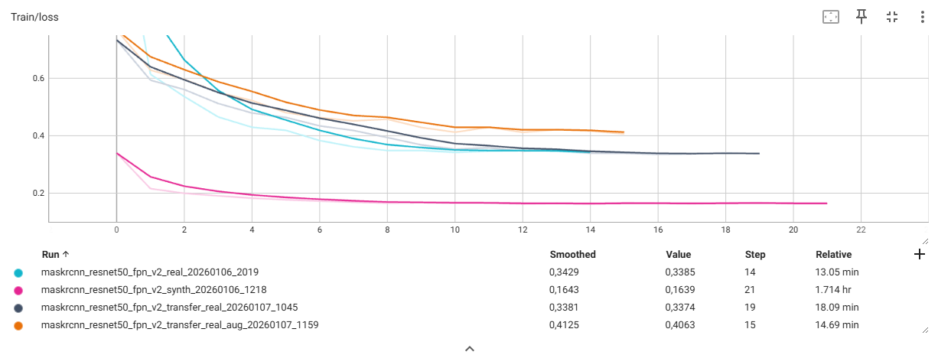
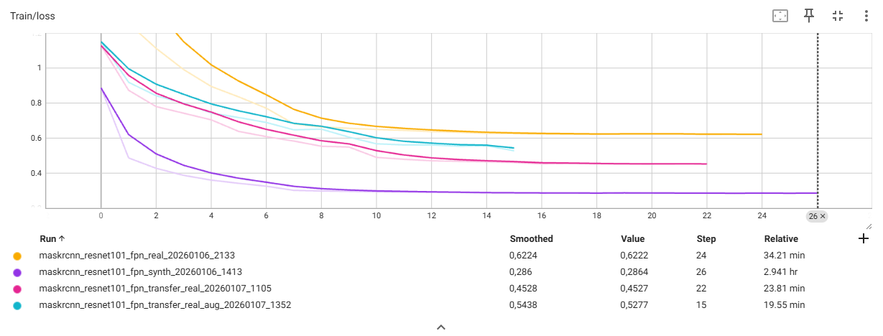
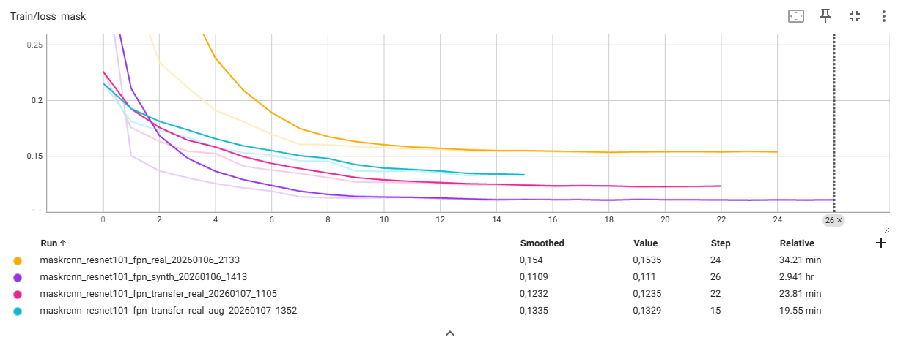
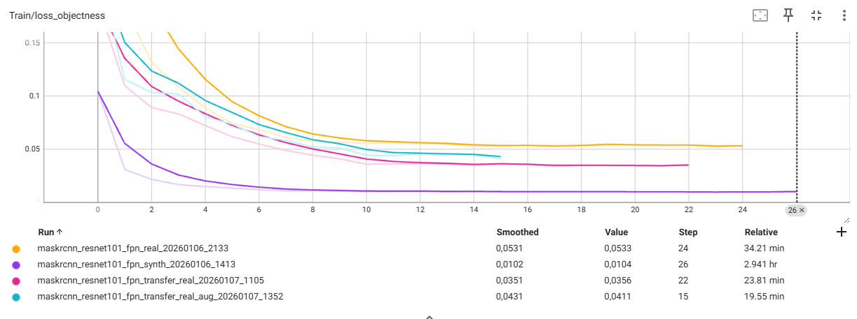
Train Loss

Slide 23
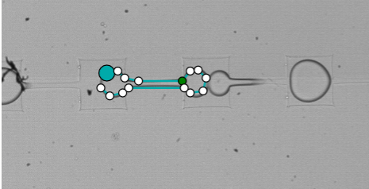
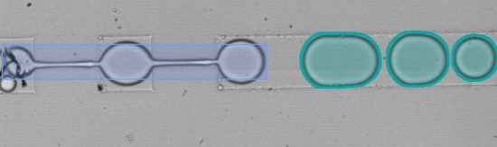
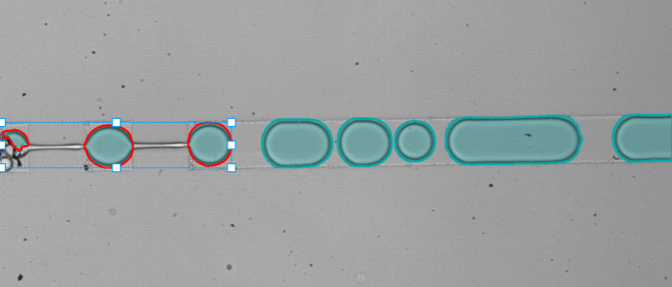
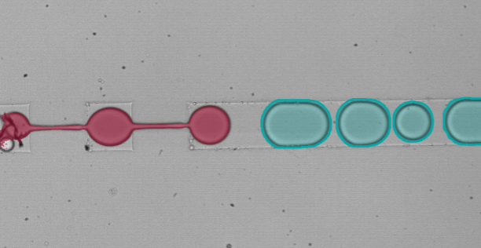
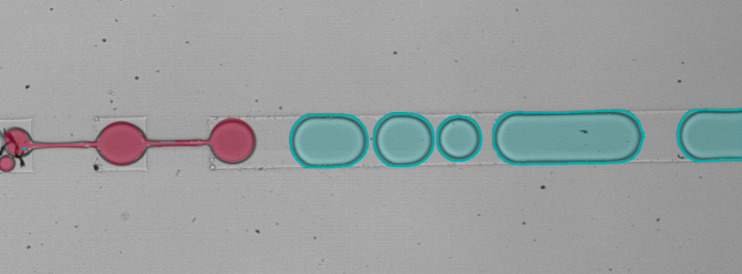
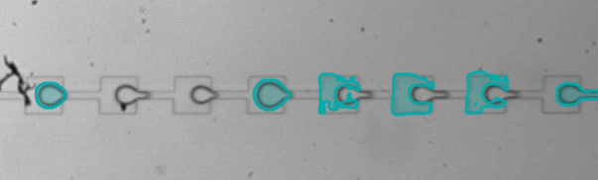
Annotation Cases

Slide 24
Metrics
Training/validation metric (checkpoint selection)
mAP (AP@[0.50:0.95]): COCO-style segmentation Average Precision, averaged over IoU thresholds 0.50, 0.55, …, 0.95. Higher is better.
Also reported during training: AP@0.50 (mAP50) and AP@0.75 (mAP75).
Used for early stopping + saving model_best.pth (best validation mAP)
Final test metrics (measurement-aligned)
Union-mask (foreground) overlap (merge all instances into one binary mask)
Precision = TP / (TP + FP) - Of the pixels labeled as bubble, how many are truly bubble?
Recall = TP / (TP + FN) - Of the true bubble pixels, how many were captured?
F1 = 2·P·R / (P + R) - Balance of precision and recall
IoU = |Pred ∩ GT| / |Pred ∪ GT| - Penalizes mismatched boundaries more.
Dice = 2|Pred ∩ GT| / (|Pred| + |GT|) - Often a bit more forgiving than IoU. Good for summarizing overall foreground match
Instance-derived indicators (from filtered predicted instances)
ΔN (signed count error) = N_pred − N_gt (bias: if model tends to overcount/undercount)
|ΔN| (absolute count error) = |N_pred − N_gt| - how wrong the count is
Mean/Median bubble area (pixels) from predicted instances
Instances are filtered with fixed thresholds (score_thresh=0.5, mask_thresh=0.5, min_area=50) for fair comparison.
Notes:
During training I select the best checkpoint using COCO segmentation mAP, specifically AP@[0.50:0.95]. This metric matches predicted instances to ground-truth instances using an IoU criterion, builds a precision–recall curve over confidence thresholds, and computes the area under that curve (Average Precision). COCO then averages AP over multiple IoU thresholds from 0.50 to 0.95, so it rewards models that not only detect the right objects but also produce accurate masks at strict IoU levels. I log mAP (plus AP@0.50 and AP@0.75), apply early stopping when it stops improving, and save the best model as model_best.pth.
For final reporting I use a separate evaluator: union-mask overlap tells me overall bubble-region delineation, but it can stay high even when bubbles are merged/split. Because the downstream goal is measurement, I also report count error (ΔN, |ΔN|) and area statistics derived from instances.

Slide 25
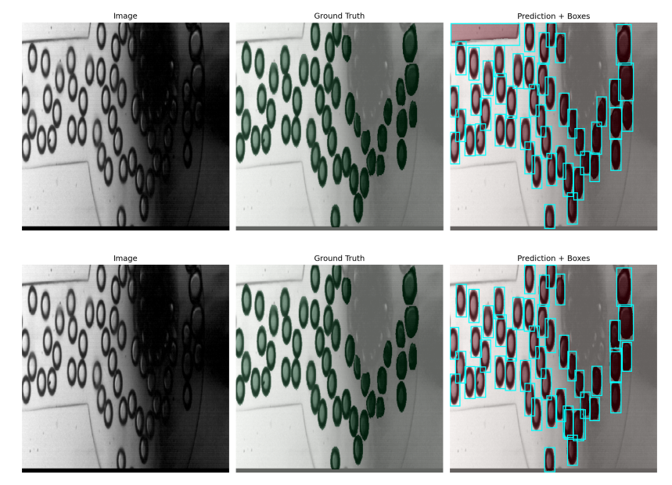
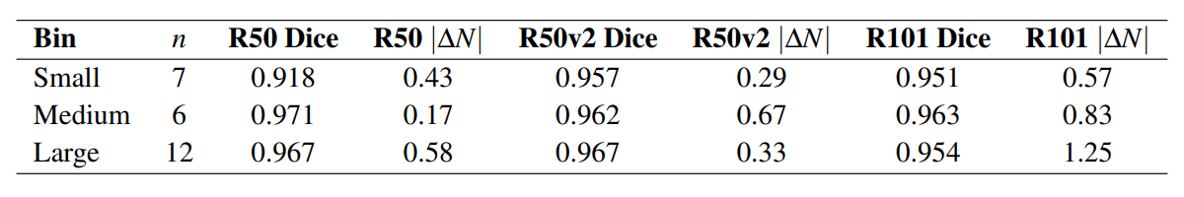
Where it fails
Why stratify? Some frames are harder due to bubble crowding and bubble scale, which affects instance separation/counting even when overlap looks good.
Setup: stratify the Transfer regime on the 25-image real test split by:
Bubble density = GT_NumBubbles percentiles → Low (1–8), Mid (9–16), High (17–48)
Bubble scale = GT_MeanArea percentiles → Small / Medium / Large
Key observation: Dice stays high, but counting stability degrades in difficult scenes, especially for higher-capacity backbone.
Example numbers (Transfer):
High density bin: R101 has higher |ΔN| (1.17) vs R50v2 (0.42) → tendency to overcount in crowded scenes.
Large scale bin: R101 |ΔN| (1.25) vs R50v2 (0.33) → extra instances / over-segmentation.
Figure 11: Stratified Dice in the transfer regime by bubble size
Table 3: Stratified performance in the transfer regime by mean bubble size
Figure 12: Dense, low-visibility case. resnet50_fpn_v2 transfer vs resnet101_fpn
Notes:
After the global results, I wanted to understand where the remaining errors happen. So I stratified the Transfer regime by two ground-truth difficulty proxies: bubble density (number of bubbles per image) and bubble scale (mean bubble area), both defined by percentiles on the 25-image test split. The important point is that Dice remains high across bins, but counting error changes much more, meaning overlap alone can look good while measurement reliability degrades. In crowded scenes and in large-bubble scenes, the ResNet-101 backbone shows higher |ΔN| and a tendency to overcount under the same fixed thresholds. The qualitative examples illustrate the dominant failure modes: bubble-like background artifacts generating false positives, and darker/denser frames increasing overprediction or fragmentation.

Slide 26
Problem context
Goal: extract reliable measurements from experimental images (bubble count, area/diameter, size distribution) – “CORRECT”
We need instance segmentation: one mask per bubble (not just foreground/background)
Why it’s hard in real experiments:
high bubble density & overlap → occlusions
lighting/contrast variability + optical artifacts
blurry/weak edges, small bubbles → split/merge errors
Main bottleneck: pixel-accurate instance labeling is expensive → small real datasets → limited generalization
Figure 1: Experimental Image showing lighting variability and blur.
Notes:
We segment bubbles because we ultimately care about measurements, not just pretty masks.
In dense experimental scenes, bubbles overlap and edges are ambiguous, so instance segmentation is required, but producing high-quality instance annotations is costly, which motivates transfer from synthetic data and annotation assistance.

Slide 27
Key challenges and motivation
Annotation bottleneck: instance-level, pixel-accurate masks are slow and hard to produce → limits the size/diversity of real labeled datasets
Domain gap: models trained on synthetic data often do not transfer perfectly to real experimental images (different noise, blur/defocus, reflections, illumination patterns)
Measurement-driven requirement: high foreground overlap (Dice/IoU) can still hide split/merge errors → poor bubble count and size statistics
Motivation for this thesis:
compare strong instance segmentation baselines on real data
evaluate synthetic → real transfer learning
quantify model-assisted annotation time savings
Figure 2: Synthetic Image
Figure 3: Real Experimental Image
Notes:
The core issues are: labeling real data is expensive, synthetic data doesn’t perfectly match real experiments, and standard overlap metrics can look good while the measurements we care about, count and bubble size, are wrong. So we test transfer learning and annotation assistance under a measurement-oriented evaluation.

Slide 28
Limitations
Limited real labeled data: 243 annotated images; test split = 25 images → high variance in estimates, limited coverage of operating conditions.
Dataset representativeness: results may not generalize to different experiments, optics, or flow regimes without additional data.
Annotation uncertainty: dense scenes have ambiguous boundaries; ground truth reflects a specific labeling protocol (no multi-annotator agreement reported).
Fixed post-processing thresholds: a single threshold set was used for fairness, but different thresholds could shift the count/FP trade-off.
Synthetic domain mismatch: synthetic pretraining helps, but cannot fully reproduce real optical artifacts → residual domain gap remains.
Notes:
The main limitations are data scale and evaluation coverage.
The real dataset is relatively small and the final test set has only 25 images, so results, especially about augmentation, have high variance and may not cover all experimental conditions.
Also, in dense frames there’s inherent ambiguity in instance boundaries, and we didn’t quantify inter-annotator variability.
Finally, I kept post-processing thresholds fixed for fairness, but the optimal operating point could differ depending on whether the priority is recall or minimizing overcount.
And while synthetic pretraining reduces the bottleneck, synthetic images still don’t capture all real optical artifacts, so some domain gap remains.

Slide 29
Future work
Scale the real dataset: collect more labeled frames and ensure broader coverage (density, lighting, optics, flow regimes).
Iterative data engine / active learning: model proposes masks → fast correction (SAM2) → retrain → repeat to improve hardest cases efficiently.
Augmentation policy redesign: make it acquisition-informed (what variability is physically plausible) and validate on a larger test/val split.
Better instance-level evaluation: add explicit split/merge-sensitive metrics or matching-based instance metrics (not only union-mask overlap).
Domain gap reduction: improve synthetic realism (optical artifacts, blur/defocus, illumination gradients) or use domain adaptation.
Notes:
The next logical step is scaling and diversifying the real dataset to reduce variance and improve generalization.
The annotation-efficiency results suggest an iterative loop: use the current model to generate pre-annotations, refine quickly with SAM2, and retrain. This targets the hardest frames with minimal extra effort.
Augmentation should be redesigned with knowledge of the acquisition process and validated on a larger evaluation split.
On the evaluation side, adding instance-matching metrics would better capture split/merge failure modes.
Finally, further reducing the synthetic–real domain gap, either by improving synthetic realism or using domain adaptation, should strengthen transfer even more.

Slide 30
Conclusions
Best overall configuration: ResNet-50-FPN v2 + Transfer→ Dice 0.9628, IoU 0.9303, |ΔN| 0.40 on the real test split.
Transfer learning matters most for measurement reliability: it reduces count bias and stabilizes instance predictions (especially for ResNet-101).
Augmentation was not consistently beneficial under this small evaluation split; policy must match the acquisition process and be tested on broader conditions. synthetic_train_pipeline
Annotation can be scaled: model-assisted labeling reduces effort by ~30× (94.49 s/bubble → 3.20 s/bubble).
Overall: a practical workflow combining synthetic pretraining + real fine-tuning + assisted annotation makes scalable bubble instance segmentation feasible.
Notes:
To conclude:
ResNet-50-FPN v2 with transfer gives the best overall balance of accuracy and speed on our real test set.
Transfer learning is key for measurement-relevant reliability, reducing count errors and bias.
Augmentation didn’t show consistent gains under a small test split, so it needs acquisition-informed design and broader validation.
Finally, the annotation study shows we can scale ground truth creation efficiently, enabling future dataset growth and more robust models.

